Slide 1
Objective 4.02
Understand pricing strategies in the fashion industry

Slide 2
Objectives of Pricing Strategies
Profitability: usually a measure of gross margin as a percentage of sales; information located on the financial reports.
Sales Volume: goals expressed in units or dollars. Higher sales volumes has increase stock turnover and impacts market share; calculate for store, dept, product lines, and individual styles.
Competition: lower price is a competition advantage for similar products
Image: Prestige motivated consumers are driven by the image of the stores and product assortments. Quality and level of customer services are key points.

Slide 3
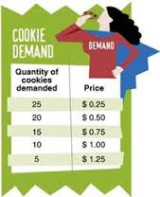
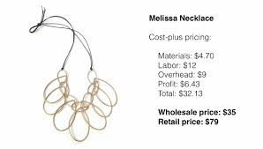
Key terms
Cost plus pricing- is a cost-based method for setting the prices of goods and services. Under this approach, you Add the cost of material, direct labor and overhead plus a markup percentage to derive the price of the product.
Basically you look at the total expenses/costs associated with making a product. Then decide to mark up by a %
Demand- the amounts of a good or service that consumers are willing and able to buy at a certain time and price.

Slide 4
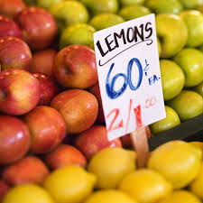
Key terms continued…
Economy pricing (Everyday Low Pricing)-a valuation technique (Strategy) which assigns a low price to products. Designed to increase store traffic because of perceived value.
example, Walmart and low prices plus their Price matching
Fixed costs-EXPENSES THAT REMAIN THE SAME REGARDLESS OF SALES VOLUME.
Example: Rent, Utilities, insurance, internet service
Gross profit- The amount of Profit you make BEFORE taking out expenses
Net profit-a resulting positive number after expenses have been deducted from the gross margin/Profit figure.

Slide 5
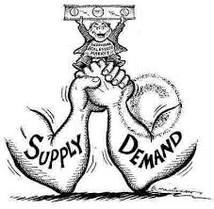
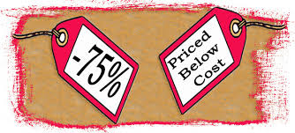
Key terms continued…
Law of supply and demand-states that when an item is scarce, but many people want it, the price of that item will rise. Conversely, if there is a larger supply of an item than consumer demand warrants, the price will fall
Loss leader-low-priced articles on which stores make little or no profit because of lowering the price for promotional reasons. Designed to increase store traffic or sales for another item.

Slide 6
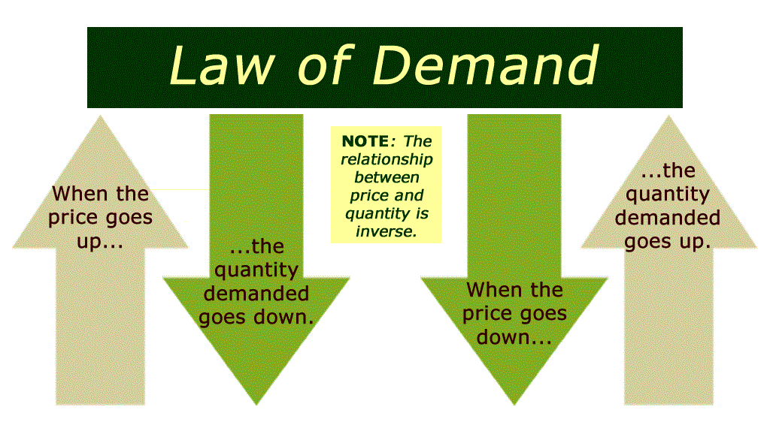
Think Gas Prices, when they go down, people generally will try to conserve the gas they use. When prices are LOW, people may travel more, therefore demand will increase

Slide 7
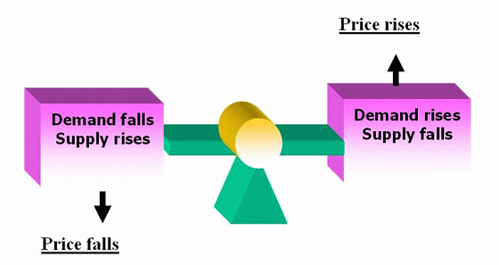

Slide 8
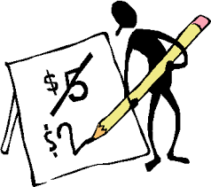
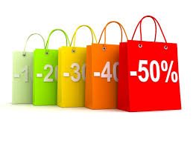
Key terms continued…
Markdown- Reducing a price that customers will pay. Can be a % or a $
Markup-amount added to the cost of merchandise to determine the selling price. (Markup=retail price-cost)
Keystone markup-doubling the cost price to arrive at the retail price. Example: ($50.00 (cost)+$50.oo=$100.00 retail price)
Sales tax-an extra percentage of a purchase collected by retailers in most states to be paid to the state government.

Slide 9
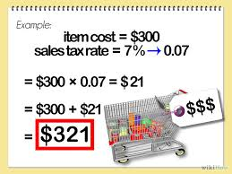
Remember, we always pay sales tax (Except on the special Tax free day in august before school each year)
ALWAys calculate your Final Selling price first.
Remember, discounts/markdowns ALWays should be taken out of the price before you calculate sales tax.
Do you want to pay tax on money you didn’t spend?!!!

Slide 10
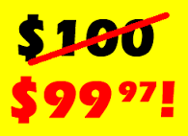
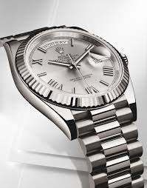
Key terms continued…
Odd-figure pricing-the retail pricing of merchandise a few cents less than an even dollar denomination.
Premium pricing (image pricing or prestige pricing)-is the practice of keeping the price of a product or service artificially high in order to encourage favorable perceptions among buyers, based solely on the price.
Think of Luxury brands like Rolex, Rolls Royce, BMW, Tiffany’s Michael kors, etc.

Slide 11
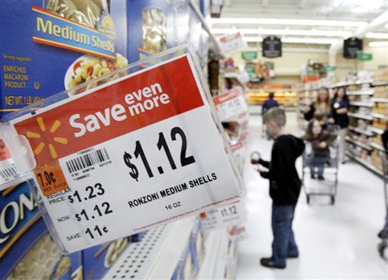
Key terms continued…
Psychological pricing-is the practice of setting prices slightly lower than rounded numbers, in the belief that customers do not round up these prices, and so will treat them as lower prices than they really are.
Designed to appeal to people’s FEELINGS. For example
Buy 2 Cookies for $1. or BOGO $1 cookies. Which one sounds better to you?

Slide 12
Key terms continued….
Supply-quantities (Amount) of a good or service that producers are willing and able to provide at a particular time at various prices.
Total costs- Fixed + Variable Costs
Variable cost-expenses that increase or decrease with the volume of sales or production. Example: Commission, wages, raw materials- The more you make, the higher the expense.

Slide 13
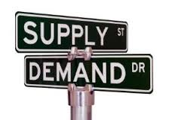
Supply and demand relationship impact on prices
Supply: Level of production
Demand: level of purchases from consumer
Law of supply and demand: supply will follow demand.
For example:
demand low-=supply low
demand high=supply high
Consumers will pay more for items in high demand or short supply. Such as:
Limited time offers
Seasonal items available just for the season

Slide 14
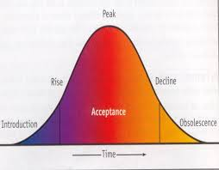
Supply and demand relationship impact on prices
The higher the supply typically the lower the price due to so many options being available to consumers; this drives down price. The product is most likely in the Peak Phase of the business cycle.
When demand drops, supply will reduce and sometimes stop completely. The product may be on the Decline Phase of the business cycle.
https://www.youtube.com/watch?v=7lPMoyzDiNo
https://www.youtube.com/watch?v=Ng3XHPdexNM

Slide 15
Strategies for using prices to attract and maintain customers
Price: the amount charged for products.
Product Positioning/Price Point: Level of quality and value placed on products. https://www.youtube.com/watch?v=o3CizbLkV8Q

Slide 16
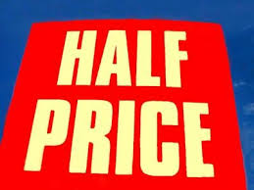
Pricing Strategies continued…
Overbuying: strategy used to build levels of price points which increases store traffic. Consumers like feeling like they are getting a great deal. Buying on sale or on clearance typically persuades larger purchases.
Liquidators: step in the channel of distribution once a product has reached the decline phase of the business cycle.
Close out Inventory: Items are combined in large lots and sold at a fraction of the original retail price.

Slide 17
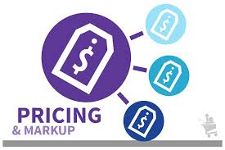
Methods for calculating retail prices
Formula for Calculating Price:
Retail Price = Cost + Markup
Markup = Retail Price – Cost
Cost = Retail Price - Markup

Slide 18
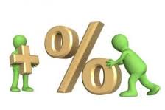
Formulas Businesses use
Final Selling Price = cost + markup (% or $)
Keystone Markup =Cost * 2
Total Expenses= Fixed expenses + Variable Expenses
Net Profit= Sales - Total Expenses
(Sales can sometimes be called Revenue or Gross Profit)

Slide 19
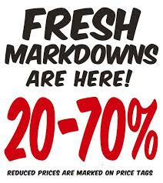
Calculating markdowns
Markdowns: Price reductions; Discounts; Typically calculated on a percentage of the retail price.
Markdown % = markdown / original retail price
Markdown % of net sales = total markdowns / total net sales
Markdown ratio: Calculated for specific time period; Used to measure the performance of departments, buyers, salespeople, and individual products

Slide 20
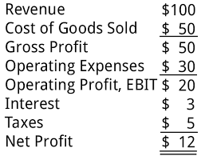
Operating Statements
Net Sales minus Cost of goods sold equals Gross Profit.
Gross Profit minus expenses equals Net Profit
Fixed Cost: expenses with a set price.
Variable Cost: expenses that vary from month to month; based on usage; utility bills

Slide 21
Price market categories
Key terms:
bridge lines-Secondary or “diffusion” lines of well-known designers priced between the designer and better categories,
Contemporary apparel-clothing that is accessible, in price and in terms of the way people wear it.
Couture-custom-made designer segment of the fashion industry for the highest priced “class” market.
Discount-clothing that is produced for the discount market or can be clothing that is sold in the off-priced market because they didn’t sell at the intended price market category.
Knockoffs-copy of another, usually higher-priced garment.
Moderate-Medium priced merchandise which is a step above budget. This is the price classification that majority of clothing and footwear fall into.

Slide 22
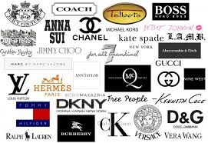
Price market categories
Designer: couture; customer made, one of a kind, very expensive, time consuming, high level of quality and service. Small market and narrow line of goods.
Bridge: Most expensive ready to wear(off the rack), produced in limited quality, expensive, limited quantity to maintain exclusivity, upscale department stores and boutiques with limited assortments.
Better: Mass production of high quality goods. Still designer labels, Located at broader selection of fine department stores.
Moderate: medium price merchandise of well known brands. Styles are Adapted from proven accepted designs. Fashion followers driven. Items are sold through chain stores. Knockoffs are copied fashion from accepted styles. They are adapted by fashion stylists.

Slide 23
Contemporary: a new classification/niche
The contemporary brands fashion market is clearly brimming with a high level of competition. The up-and-coming contemporary designers are forced to continuously compete with older, established luxury brands in the targeting of the younger generation of consumers.
The contemporary market began out of consumers’ need and want to own versatile clothing that could be worn on a daily basis. Stylish consumers were hungry for locating a head-to-toe outfit that luxury brands create, but could be sold at a more reasonable price point.

Slide 24
Contemporary: a new classification/niche
The luxury industry makes clothing for occasions that are special, not for a woman’s everyday life. Designer collections and Haute Couture lines are great, but trendy women with a little less money to burn needed an alternative. Contemporary apparel is clothing that is accessible, in price and in terms of the way people wear it.
The contemporary category often contains more modern-style clothes compared to the higher end luxury market. The voice of the contemporary industry is a bit more modern and a tad younger (not always, but often).

