Slide 1
Variations of the Fashion Cycle
FM 1.01 3A

Slide 2
The fashion cycle
Fashion cycle: The ongoing introduction, rise, peak, decline, and obsolescence in popularity of specific styles or shapes.
All styles that come into fashion rotate through the fashion cycle.
Fashion acceptance can be illustrated using a bell-shaped curve.

Slide 3
The fashion cycle (cont.)
The cycles for some styles are exceptions to the bell-shaped curve.
Flops: Fashions that are introduced and expected to sell but that are not accepted by consumers.
Fads: Temporary, passing fashions that have great appeal to many people for a short period of time; styles that gain and lose popularity quickly. Examples: go-go boots, Nehru jackets, legwarmers
Classics: Styles that continue to be popular over an extended period of time even though fashion changes; styles that remain in fashion year after year. Examples: blazers, denim jeans, men’s dark suits, the Chanel suit, loafers

Slide 4
Stages of the fashion cycle
Introduction
Rise
Peak
Decline
Obsolescence

Slide 5
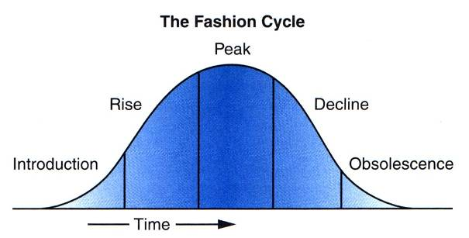
Stages of the fashion cycle

Slide 6
Stages of the fashion cycle (cont.)
Introduction: The first stage of the fashion cycle when new styles, colors, textures, and fabrics are introduced.
The new style may be accepted by a small number of people called fashion leaders.
Promotional activities include fashion shows and advertising in high fashion magazines.

Slide 7
Introduction (Cont):
Fashions are produced in small quantities at high prices.
Retail buyers purchase limited numbers to see if the style will be accepted.

Slide 8
Stages of the fashion cycle (cont.)
Rise: The second stage of the fashion cycle when consumer interest grows and the fashion becomes more readily accepted by consumers.
Mass production brings down the price of the fashion, which results in more sales.
Styles are manufactured in less expensive materials and in lower quality construction than the original style.

Slide 9
Rise (Cont.)
Promotional efforts are increased in high fashion magazines to heighten consumer awareness.
Retail buyers order items in quantity.

Slide 10
Stages of the fashion cycle (cont.)
Peak (Culmination stage): The third stage of the fashion cycle during which a style is at its height of popularity.
The fashion is demanded by almost everyone because it is now within the price range of most consumers and is mass produced in many variations.
Each retailer tries to persuade customers that its version of the style is the best.

Slide 11
Stages of the fashion cycle (cont.) Peak (Culmination stage)
The style may have a long or short stay at this stage.
Short-run fashions: Styles that are popular for a brief period of time.
Fads, usually lasting only one season
Accepted and rejected quickly

Slide 12
Short-run fashions (cont.)
Teenagers’ fashions change the fastest and have the most trends.
Styles are easy for the manufacturer to produce and are relatively inexpensive to the consumer.
Styles typically have more details than seen in classics.

Slide 13
Stages of the fashion cycle (cont.) Peak (Culmination stage)
Long-run fashions: Styles that take a long time to complete the fashion cycle.
Classics, basics, and/or staple fashions
Slow introduction, long peak, slow decline
Styles have simple lines, minimal detail.

Slide 14
Stages of the fashion cycle (cont.)
Decline: The fourth stage of the fashion cycle when the market is saturated and popularity decreases.
The fashion is overused and becomes dull and boring.
As the fashion decreases in popularity, retailers mark down their prices.
Promotions center around major clearance or closeout sales of the fashion.

Slide 15
Stages of the fashion cycle (cont.)
Obsolescence: The fifth stage of the fashion cycle when the style is rejected, is undesirable at any price, is no longer worn, and is no longer produced.

Slide 16
Lengths of fashion cycles
Cycles have no specific lengths.
Recurring fashions: Styles which have been in fashion at one time, gone out of fashion, and come back in fashion again.
Fashion trends seem to recur about every generation or every 20 to 30 years.
Example: shawls and ponchos of the 1980’s reintroduced and accepted in 2004
Fashion cycles are less distinct now than in the past.
Example: acceptance of all skirt lengths

