Slide 1
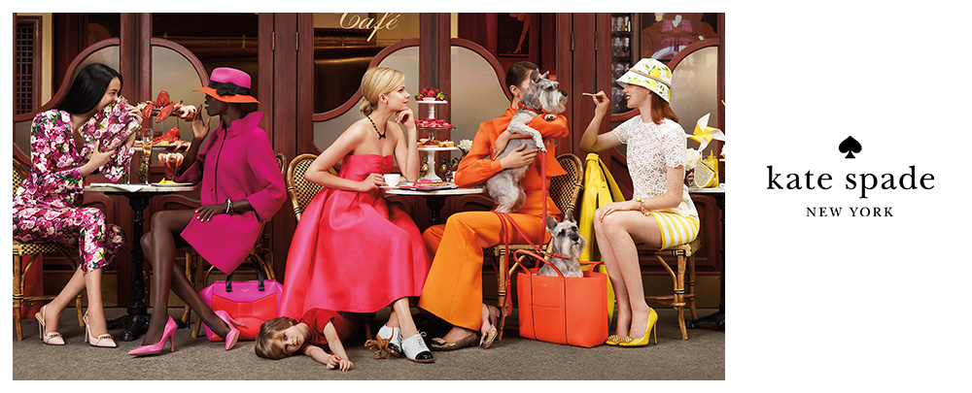
Unit 6.00 Understand the promotion of a fashion image.
6.02 Understand visual merchandising and display techniques of fashion..

Slide 2
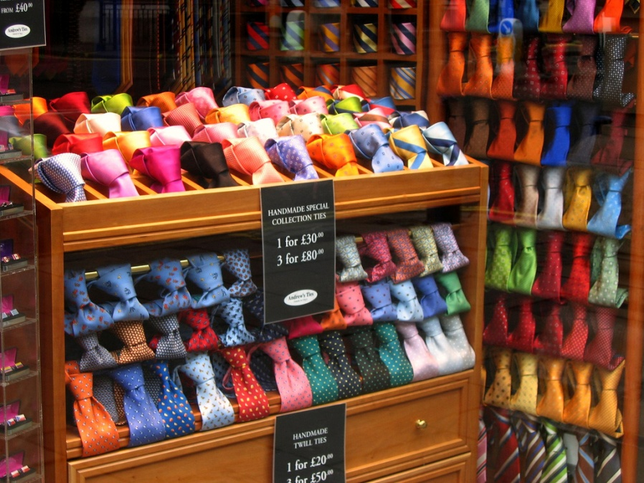
Essential Questions: Turn to your neighbor and discuss…
What is the importance of visual merchandising?
How does décor, atmospherics, and store layout influence visual merchandising?
How should merchandise be presented?
How are the components of visual displays classified?
What are the techniques for visual merchandising?

Slide 3
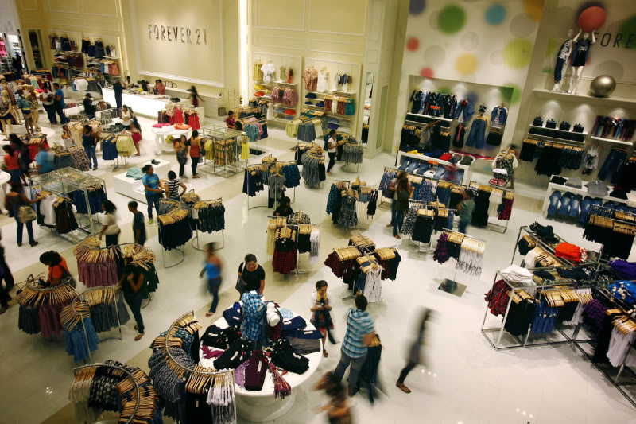
Visual Merchandising
Visual Merchandising is the physical display of goods in the most attractive and appealing ways. The goal is to please your customers as they enter and walk around your store.

Slide 4
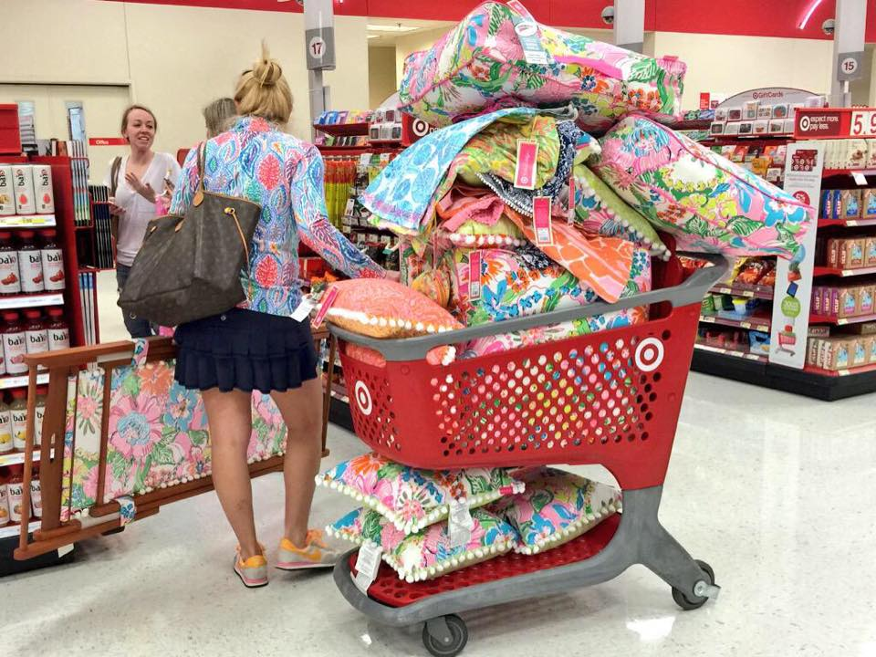
Key Terms for visual merchandising:
Atmospherics-features intended to create a particular emotional mood or attitude, such as sound, color or smell.
Note: Fashion retailers want shoppers to enjoy being in their store! This encourages customers to stay longer and buy more!
Like this lady!

Slide 5
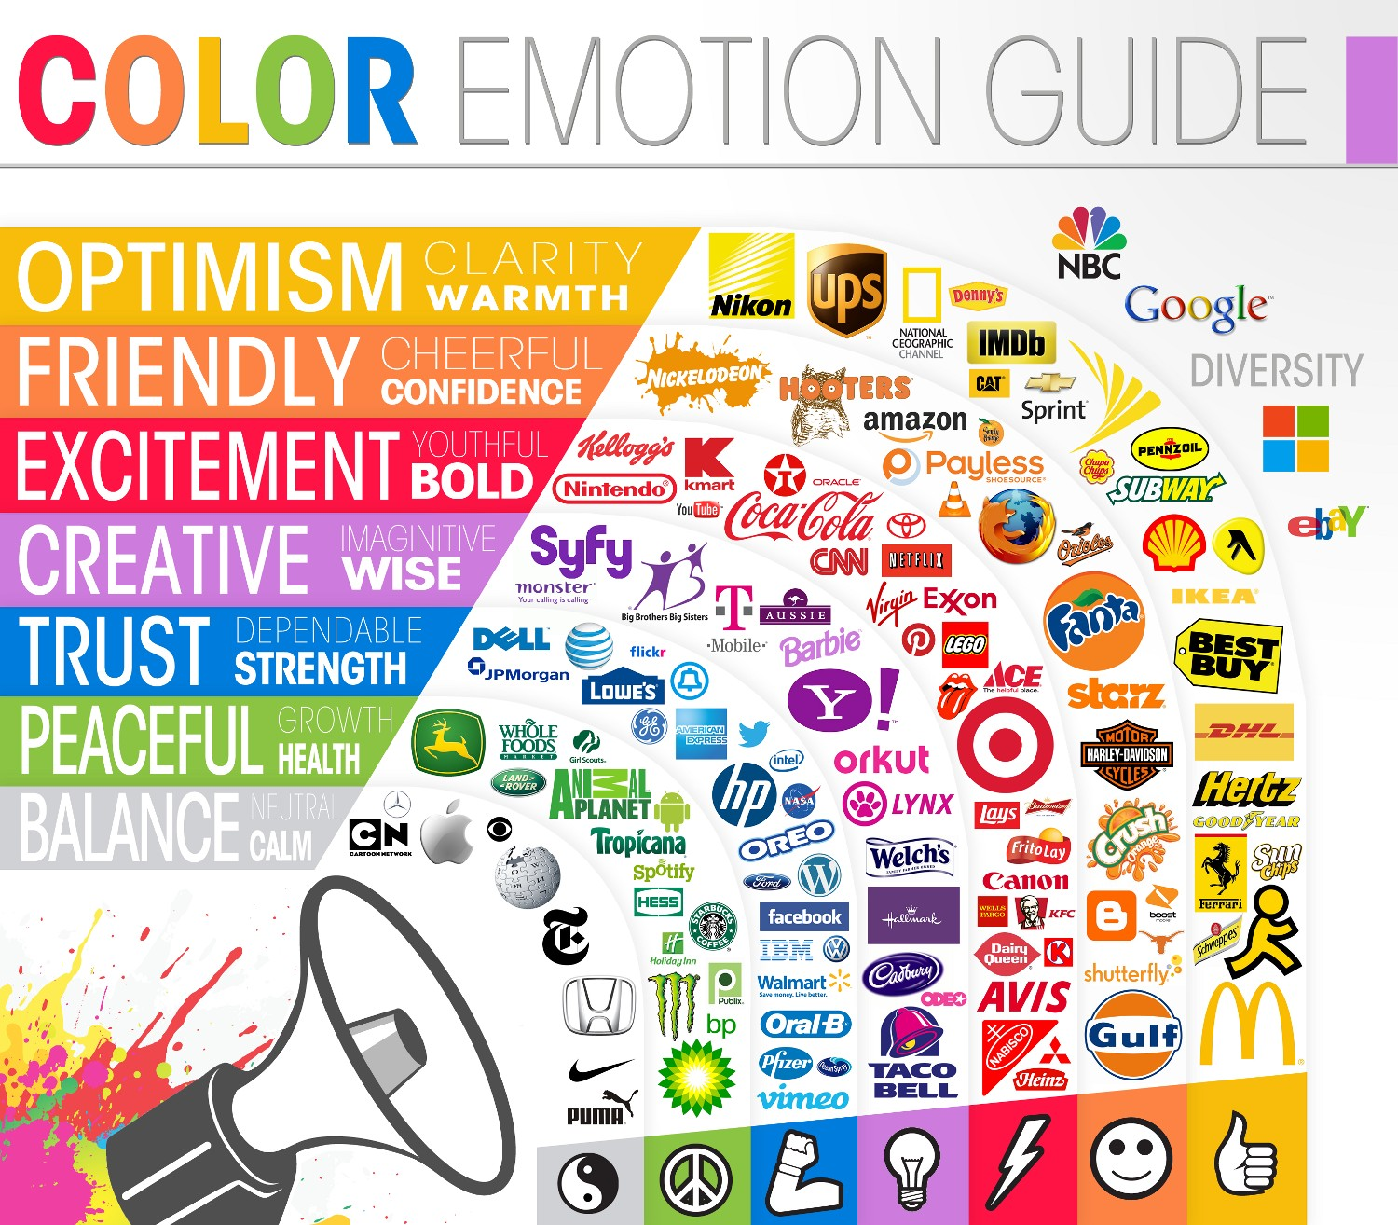
Atmospherics

Slide 6
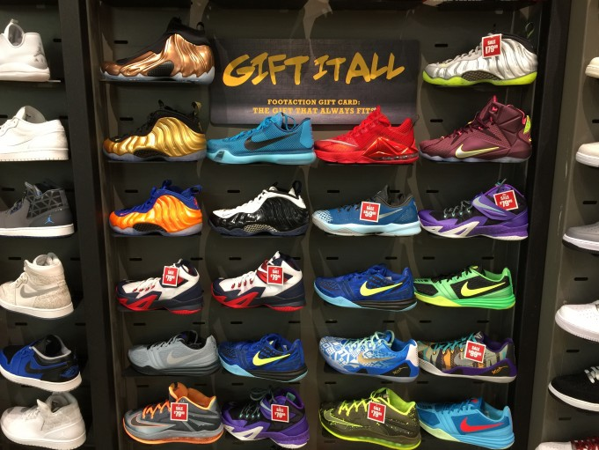
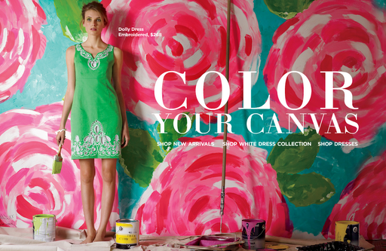
Key Terms for visual merchandising:
Décor: the style and appearance of interior furnishings
Face-forward presentation: face-out presentation of apparel merchandise by hanging the front to fully face the viewer
Fixtures: shelves, tables rods, counters, stand easels, forms, and platforms on which merchandise is stocked and displayed.

Slide 7
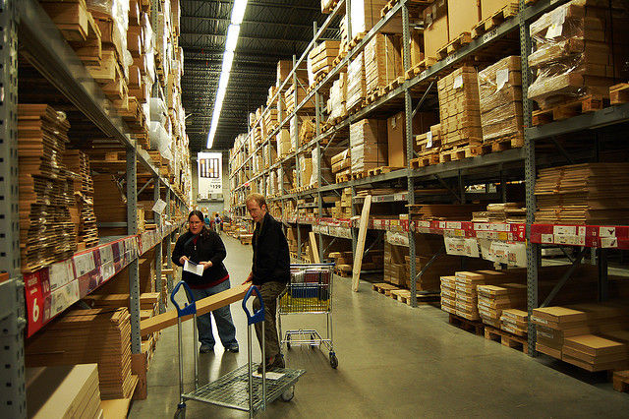
Key Terms for visual merchandising:
Merchandise presentation: The way that goods are hung, placed on shelves, and otherwise made available.
Grid layout: A retail floor plan that has one or more primary aisles running through the store, with secondary smaller aisles intersecting with them at right angles.
Maze layout: A free-flowing retail floor plan arrangement.

Slide 8
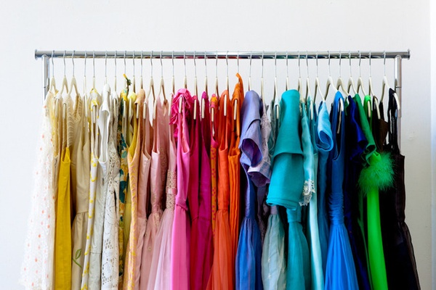
Key Terms for visual merchandising:
Sales support areas: store spaces devoted to customer services, merchandise receiving and distribution, management offices, and staff activities.
Selling areas: store layout areas where merchandise is displayed and customers can interact with fashion sales personnel.
Shoulder-out presentation: a way of hanging garments with only side showing.

Slide 9
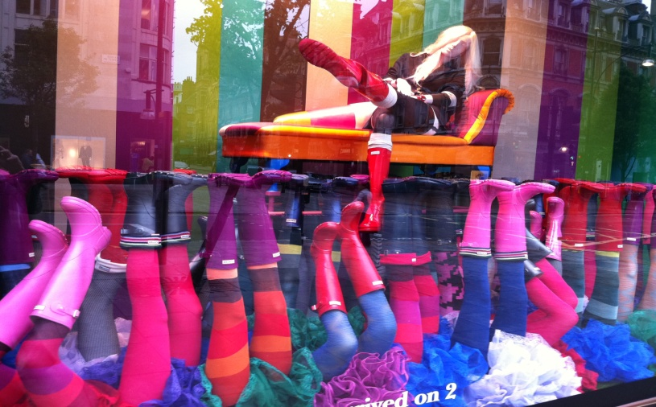
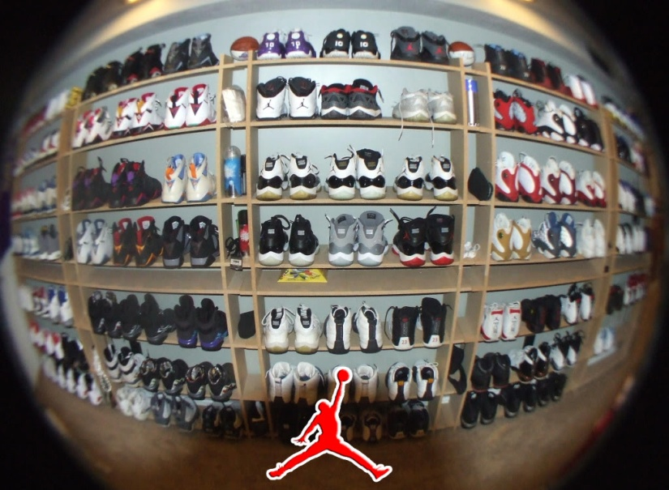
Importance of visual merchandising
Similar to other forms of promotion, the sole purpose of visual merchandising in fashion is to sell fashion goods and services and promote the store image.
It also serves as an educational tool that informs consumers of new trends in color, fabrics, and how items can be worn.

Slide 10
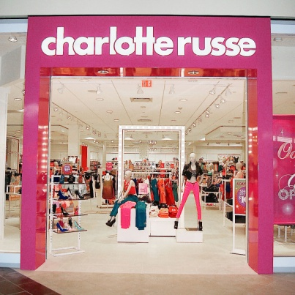
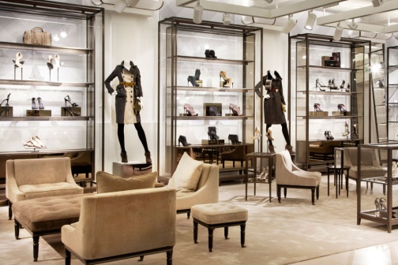
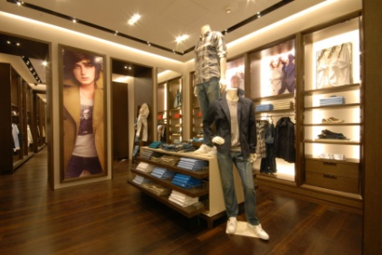
Impact of influences of visual merchandising mini activity:
Discuss different fashion retailers with a partner and describe the layout, displays, atmospherics, and décor of each.
Groups should select five retailers from their findings of the visits to prepare a presentation for the class.
The presentation should cover how layout, displays, atmospherics, and décor impact a store’s overall image and customers’ shopping behavior.

Slide 11
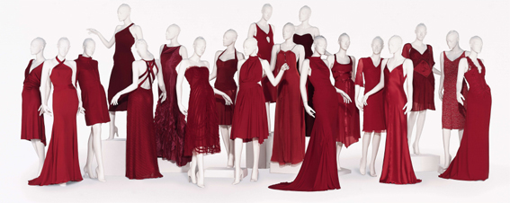
Arrangements of presenting merchandise
Enclosed windows: Display windows with a full background and sides that completely separate the store’s interior from the display window.
Island windows: four-sided, lobby display windows that stand alone and can be viewed from all sides.
Mannequins: Lifelike human forms.

Slide 12
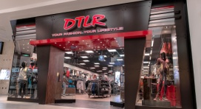
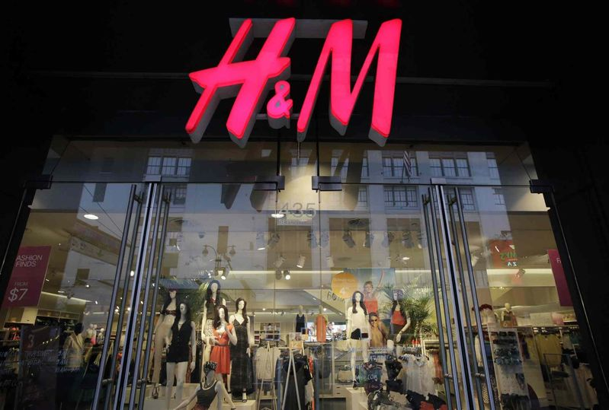
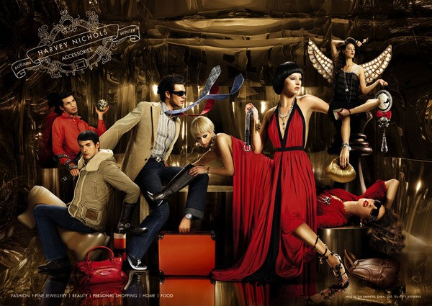
Arrangements of presenting merchandise
Open windows: Display windows that have no background panel at all, with outside visibility into the store.
Props: Added objects that support the theme of the display.
Semi-enclosed windows: Display windows that have a partial background that shuts out some of the store interior from those viewing the window.
Signage: The total of all the informational plaques of a store or location.

Slide 13
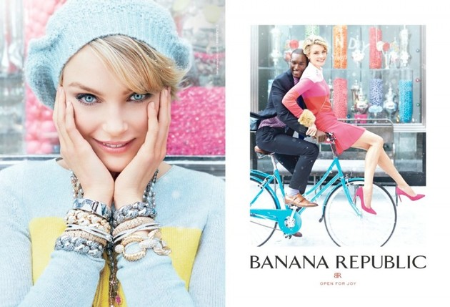
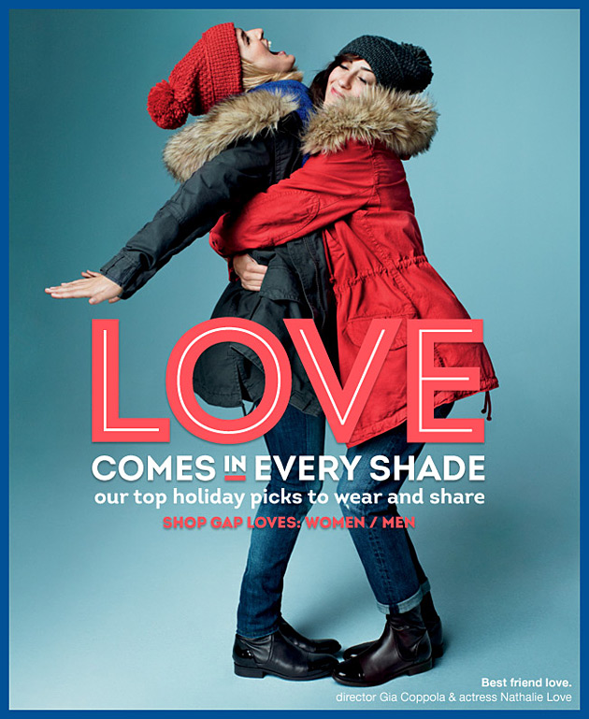
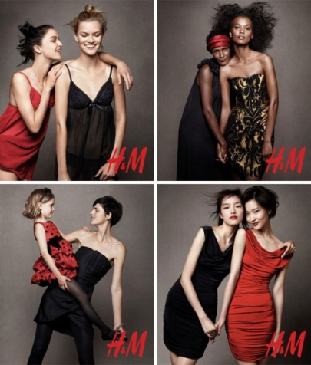
Visual Merchandising During the Holidays

Slide 14
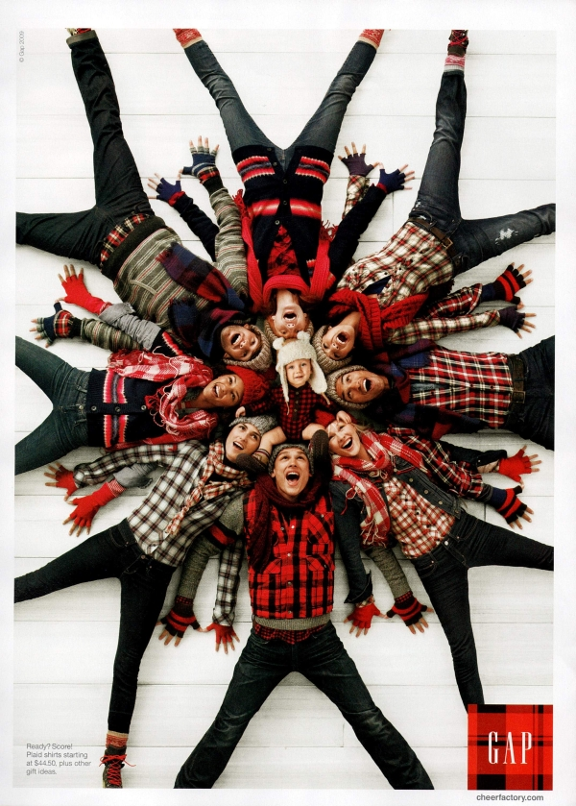
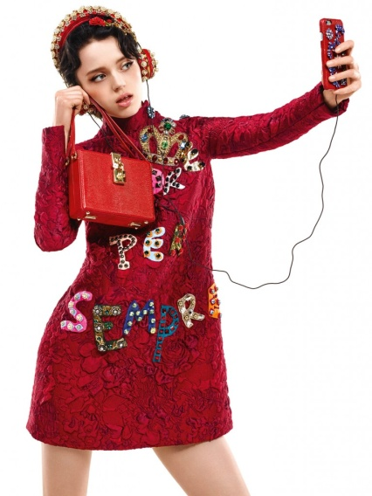
Visual Merchandising During the Holidays

Slide 15
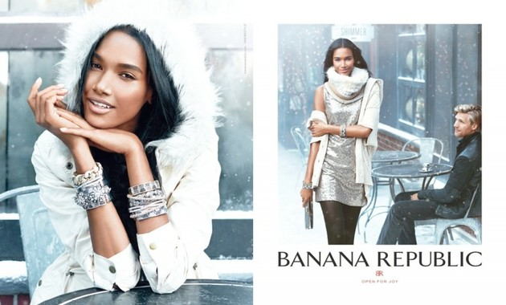
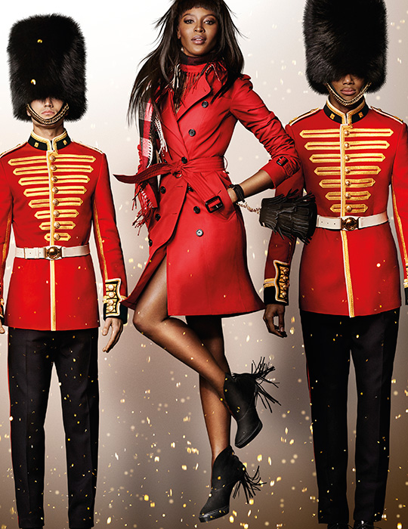
Visual Merchandising During the Holidays

