Slide 1
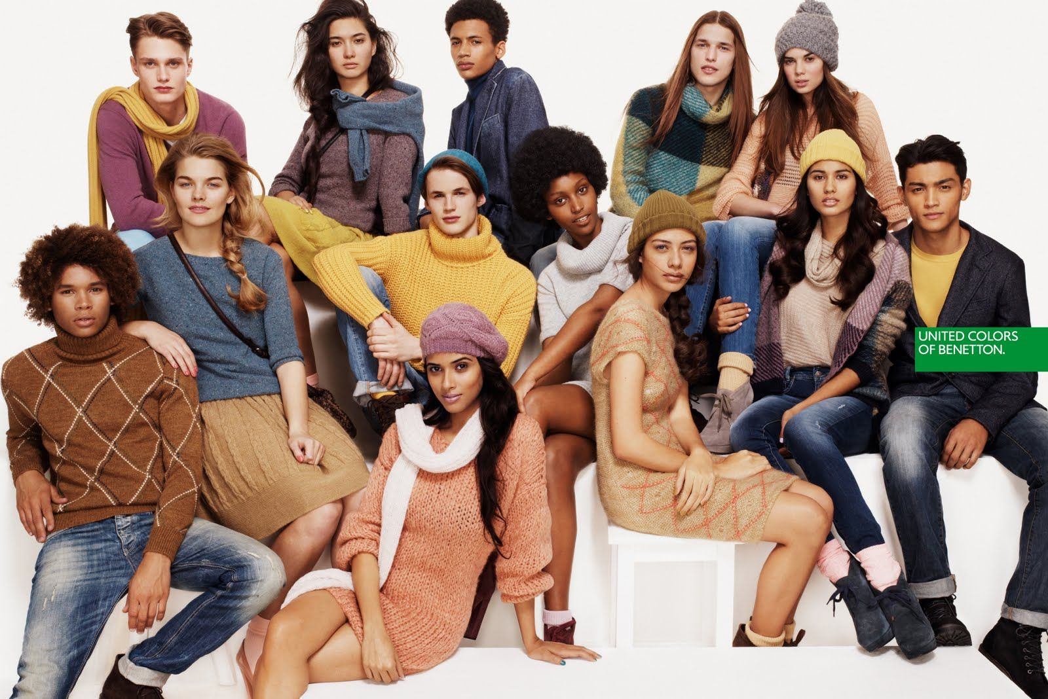
Unit 6.00 Understand the promotion of a fashion image.
6.01 Understand the promotional messaging of fashion.

Slide 2
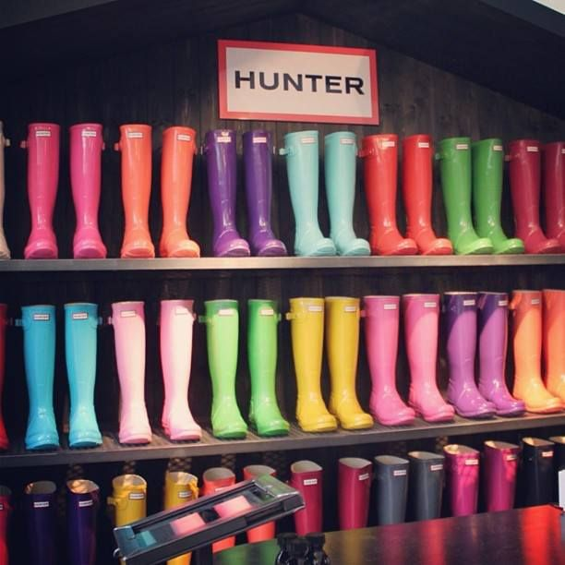
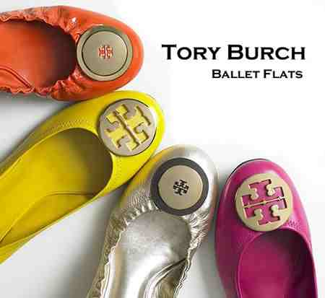
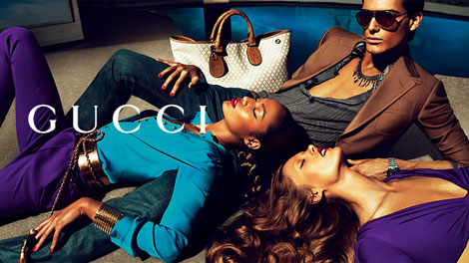
Essential Questions: Turn to your neighbor and discuss…
What are the goals of fashion promotion?
What are the differences among advertising types?
What are examples of the advertising forms?
What are the trends in fashion promotion?
What is the importance of public relations and publicity in fashion promotion?

Slide 3
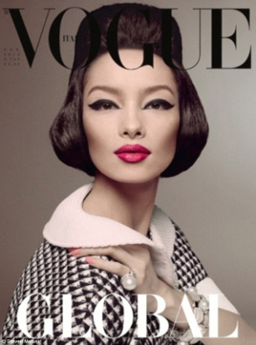
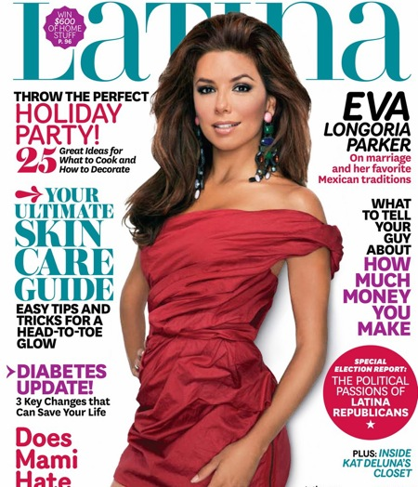
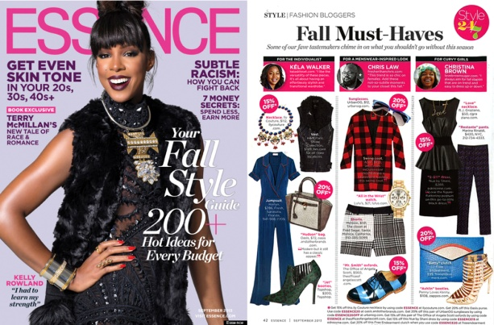
So, what exactly is Advertising?
Advertising: Any paid form of non-personal sales message made by an identified sponsor through a mass communication medium.

Slide 4
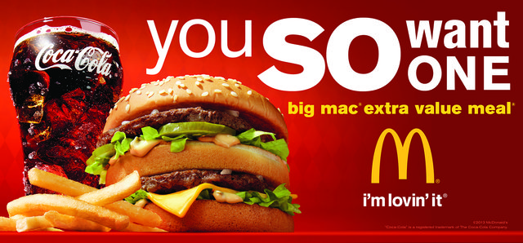
Ok, so now I know what advertising is. What are the various forms?
Cooperative advertising is advertising where a retailer or a wholesaler share the costs of an advertising campaign with the manufacturer of the product being advertised.

Slide 5
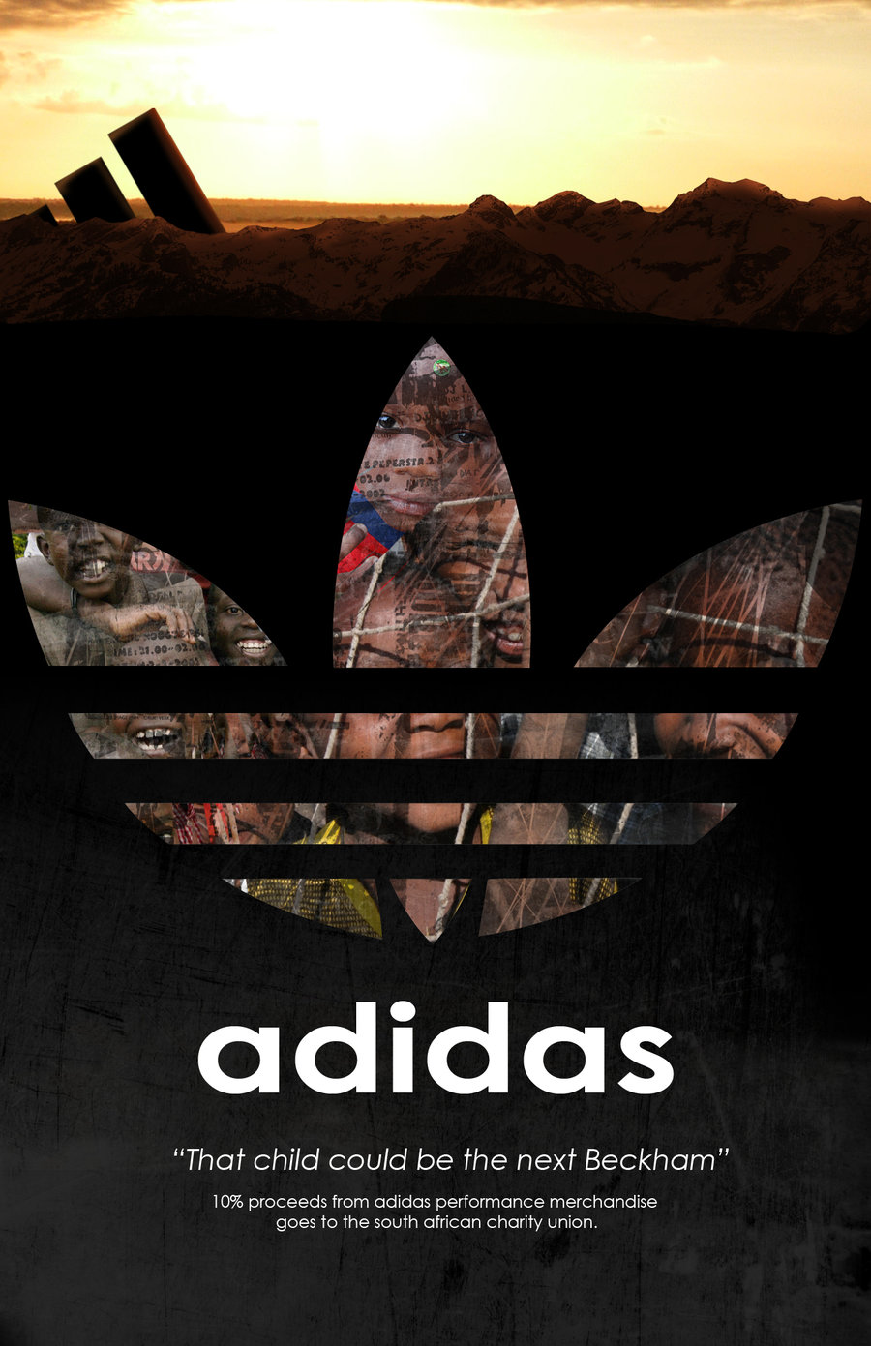
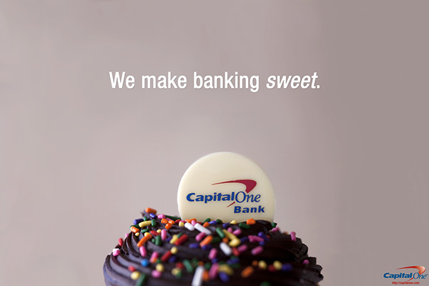
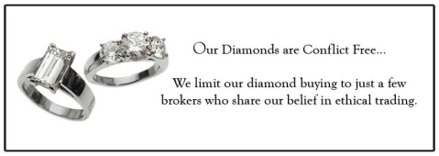
Does your reputation really matter?
Institutional advertising: Type of advertising designed to sell the reputation of a business rather than a specific product.

Slide 6
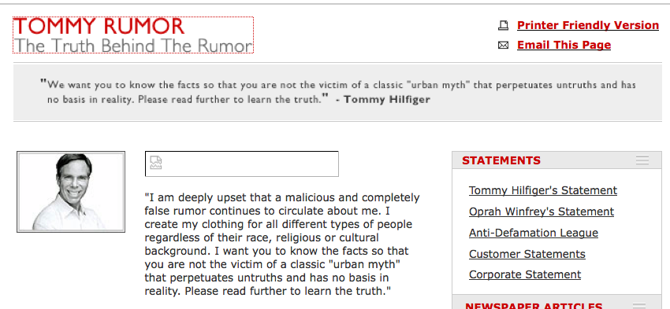
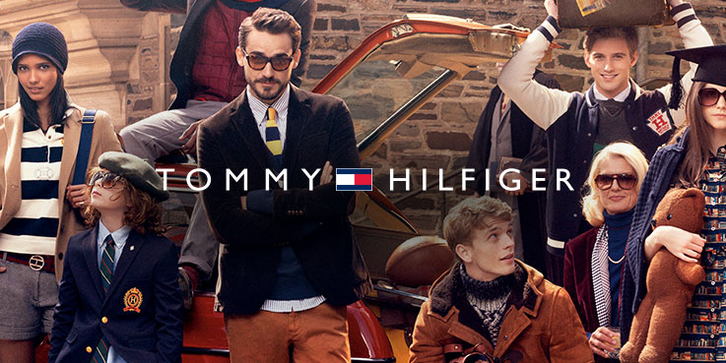
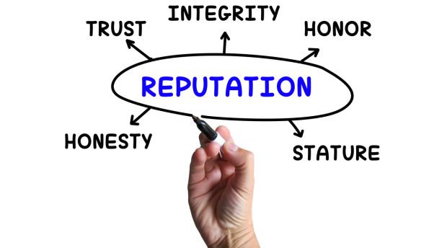
Discuss the importance of a good reputation with your neighbor.
Why is it important to have a good business reputation?
How can your reputation help, or harm your business?
What business have you not visited based entirely on their reputation?

Slide 7
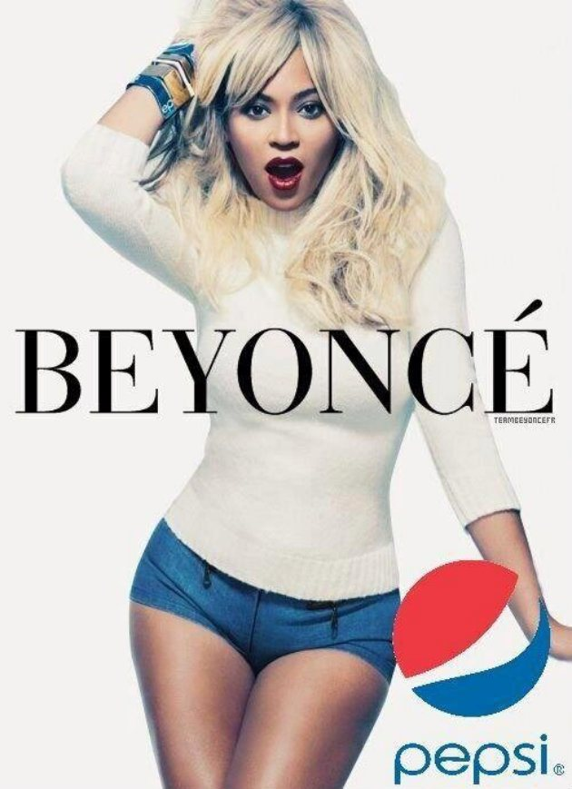
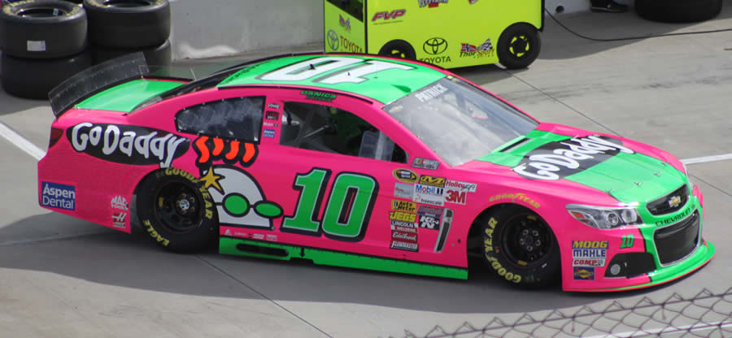
Find an example…
Look through fashion magazines, newspapers, sales circulations and websites for examples of the advertising types.

Slide 8
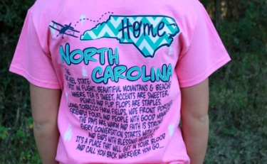
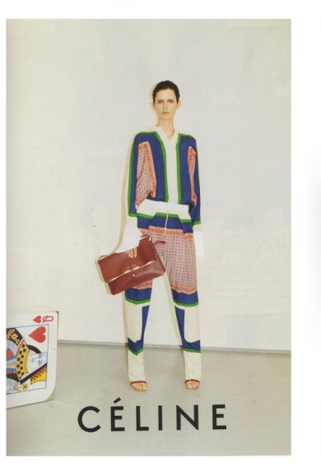
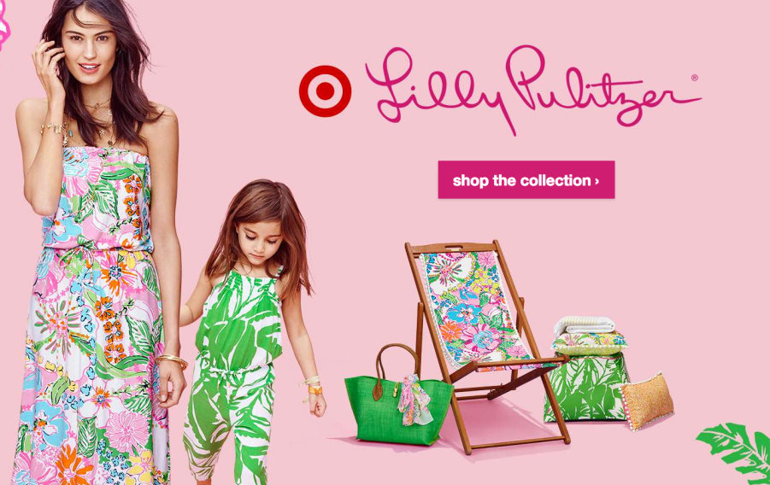
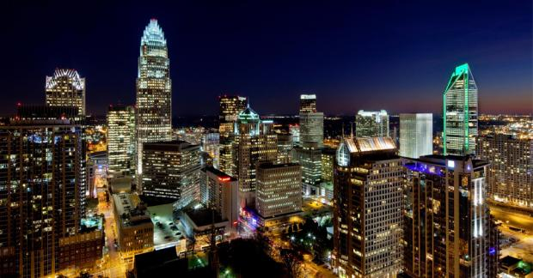
Geographic Scope of Advertising
Worldwide
National
Regional
Local
National Ad’s

Slide 9
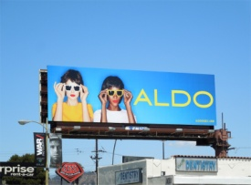
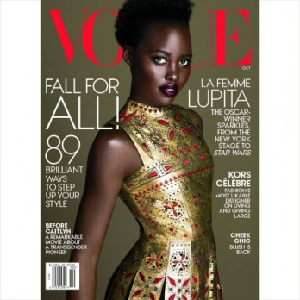
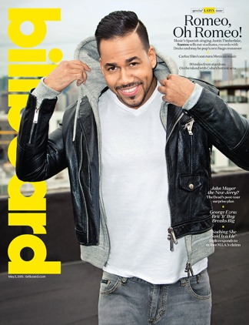
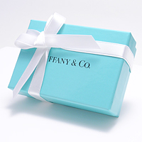
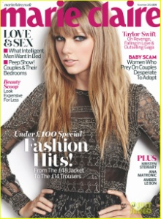
Now that we know the types of advertising what exactly are the various media forms?
Outdoor
Signage
Newspapers
Magazines
Outdoor
Direct Mail
Merchandise Packaging
Packaging
Magazines

Slide 10
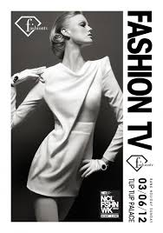
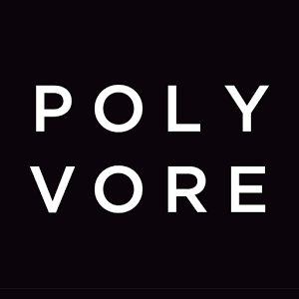
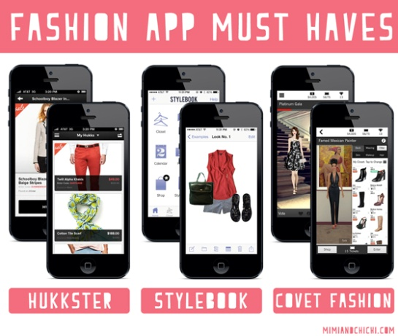
Other types of media forms…
Radio
Telephone and Business Directories
Television
Video
Websites
Radio
Websites

Slide 11
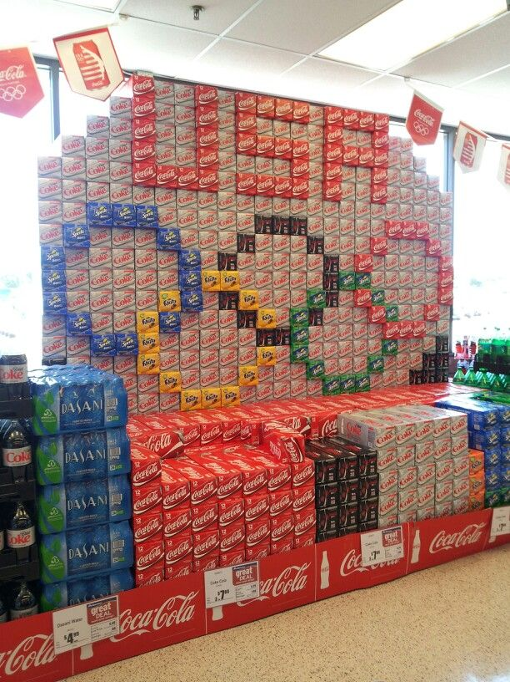
Promotion
Trade promotion: Type of promotion aimed within the industry.
Consumer: Type of promotion aimed directly to consumers

Slide 12
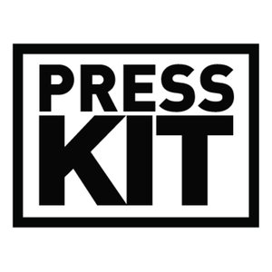
Promotion
Product promotion: Type of advertising designed to sell specific, identifiable merchandise items, lines or services.
Publicity: Unpaid media coverage of news about an organization presented at the discretion of the media.
Promotional Program: Written guide that details all of a company's promotion efforts for a given time period.
Press Kit: A promotional collection of materials presented as a portfolio with press releases and photographs &/or illustrations.

Slide 13
Promotion
Public relations: Activities that try to build good relations with the various publics of an organization or product line.
Retail: Type of promotion used by retailers to attract customers.
Cooperative: The sharing of advertising and its costs by two or more organizations.
Promotional mix: Combination of all types of persuasive communication used by an organization to market itself & increase sales

Slide 14
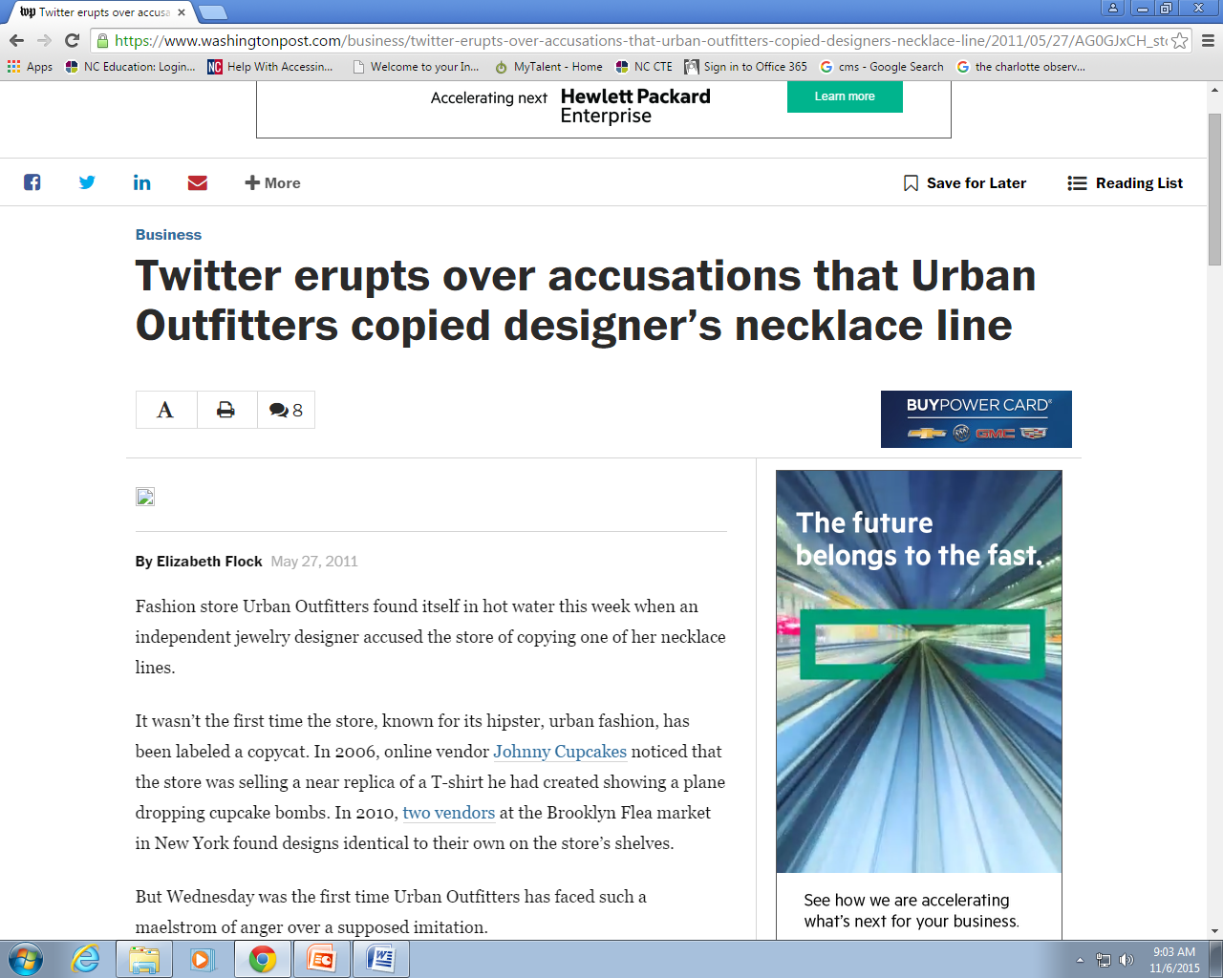
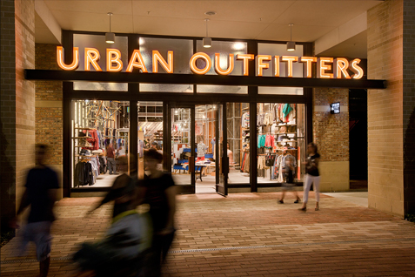
PR Case Study: Twitter erupts over accusations that Urban Outfitters copied designer’s necklace line available at website.
Read this article and let’s discuss!

Slide 15
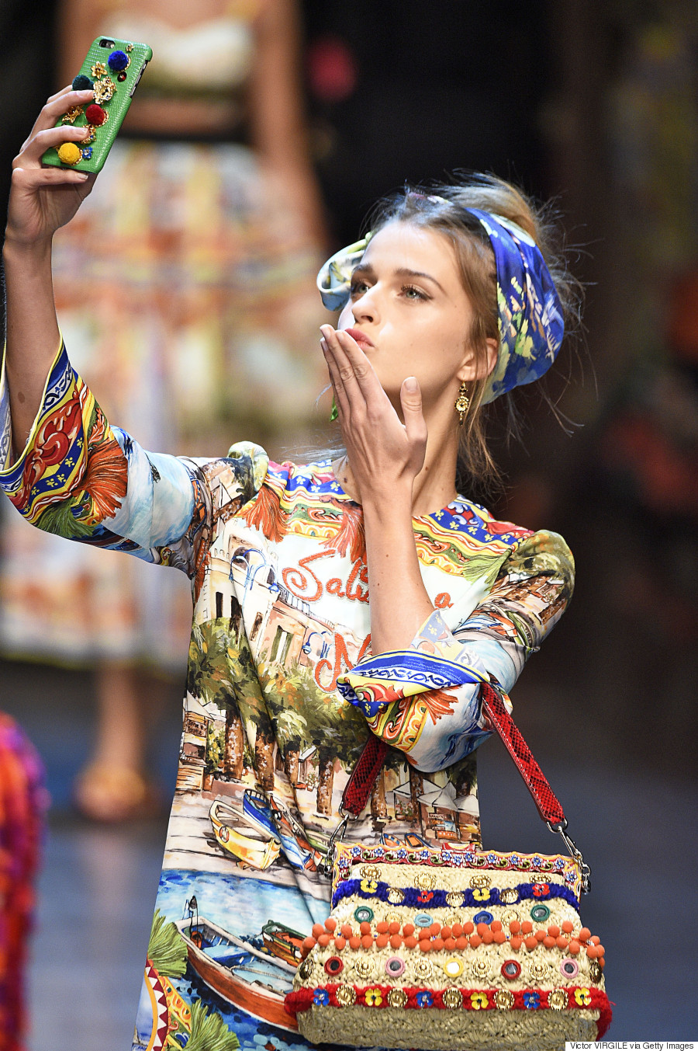
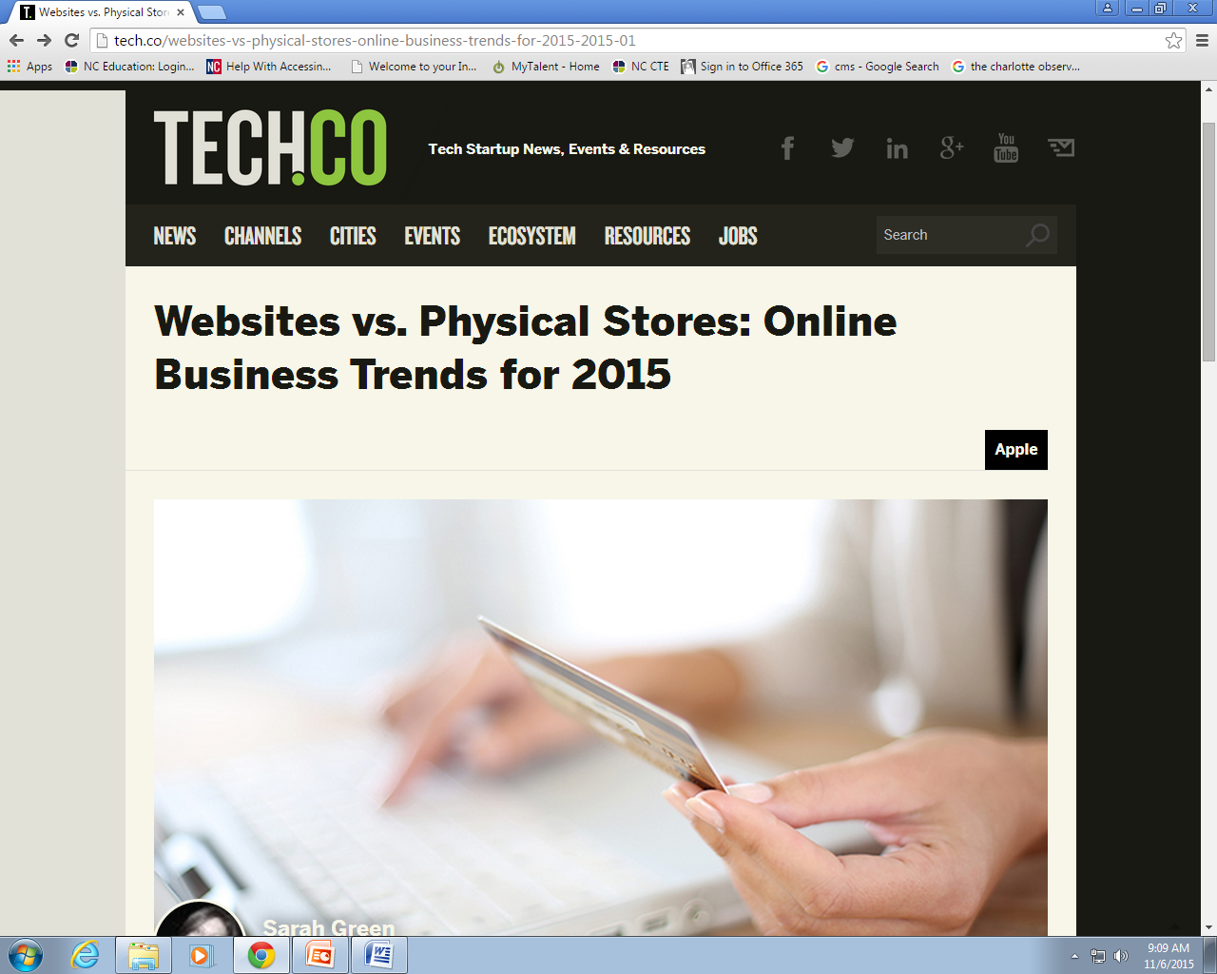
What are the trends in fashion promotion?
Check out this article!

