Slide 1
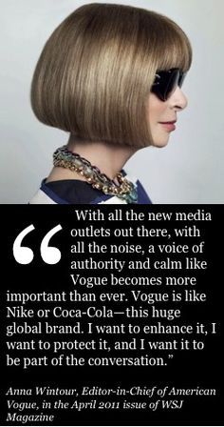
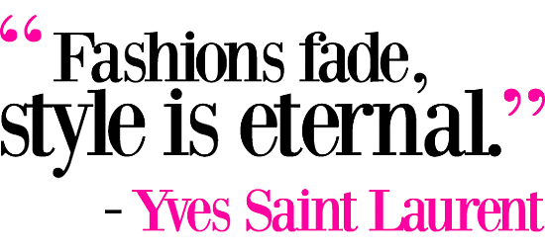
Fashion Marketing 4.01 B Notes

Slide 2
Expansion
(Growth)
Peak
Recession
Trough/
Depression
Everything grows, production, employment, output, wages, supply, etc.
Growth Slows, people start to slow down with their purchases
Decreased production, prices decrease, unemployment increases
A recession that reaches its low point. Many weak companies are forced out of business. unemployment at its worst
Business Cycles

Slide 3
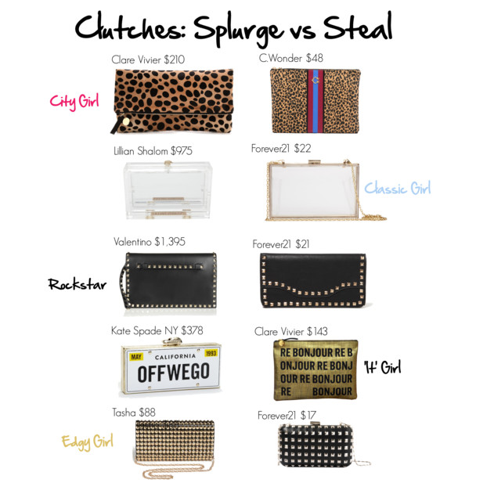
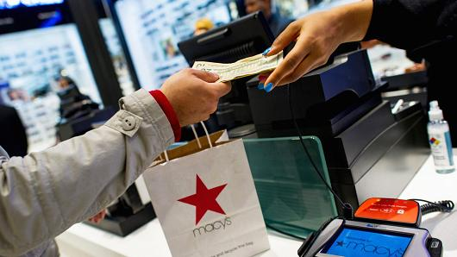
Business Cycles
Business cycles are fluctuations in the level of economic activity over periods of several years
Recessions result in a drop in consumer confidence in the economy
This causes lower retail sales, which signals factories to produce less
Fashion products are affected strongly by economic recessions and expansions
continued

Slide 4
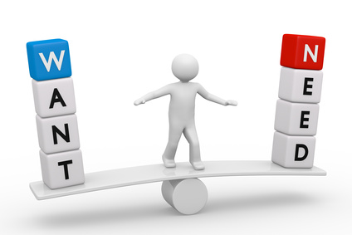
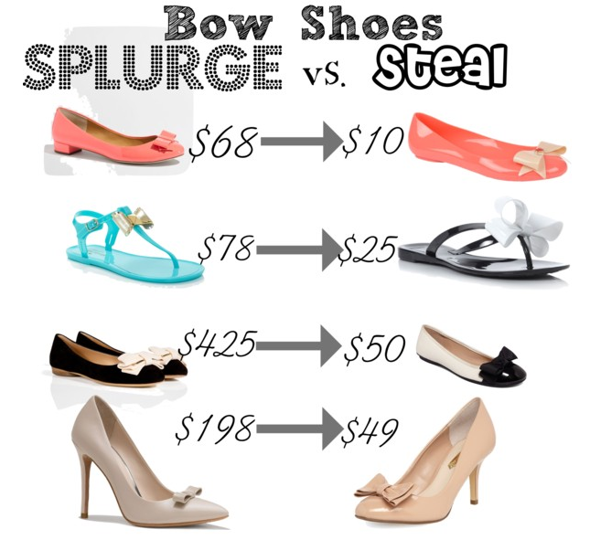
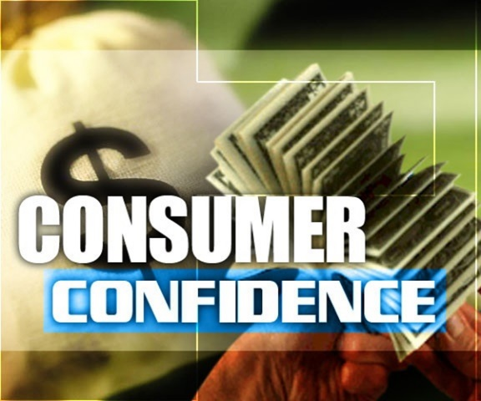
Business Cycles
Fashion goods have faster and deeper recessions than do the more-necessary items
When the economy is growing, the market for fashion merchandise often grows faster than the general economy
During more prosperous economic times, consumers buy more costly apparel items

Slide 5
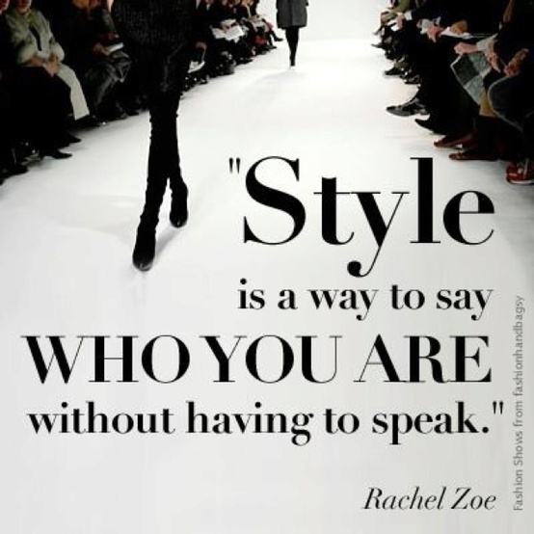
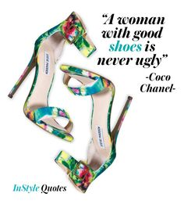
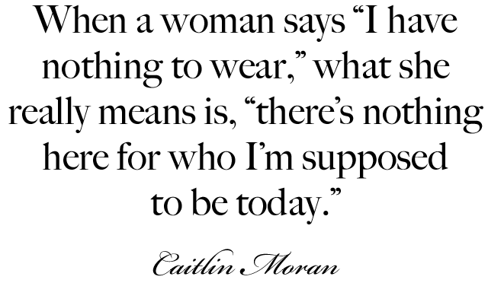
The Concept of Marketing
Marketing is the total process of finding or creating a profitable market for specific goods or services
To be successful, a company must have products that consumers desire
In the past, manufacturers and retailers had a product-oriented approach to business rather than a marketing approach
Remember, qualified customers are WILLING and ABLE to pay for a product

Slide 6
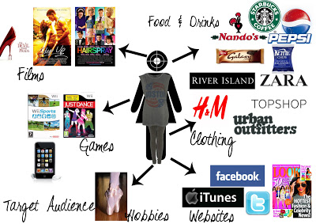
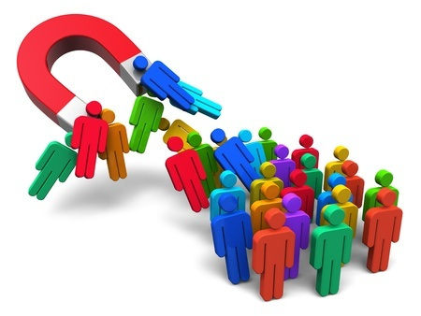
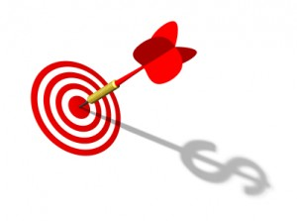
Industry Facts
To succeed in this approach requires
defining its target market, which is the specific segment of a total market that a company wants as customers
directing marketing efforts at these customers
Today’s marketing-oriented approach focuses on determining customer desires before goods are manufactured

Slide 7
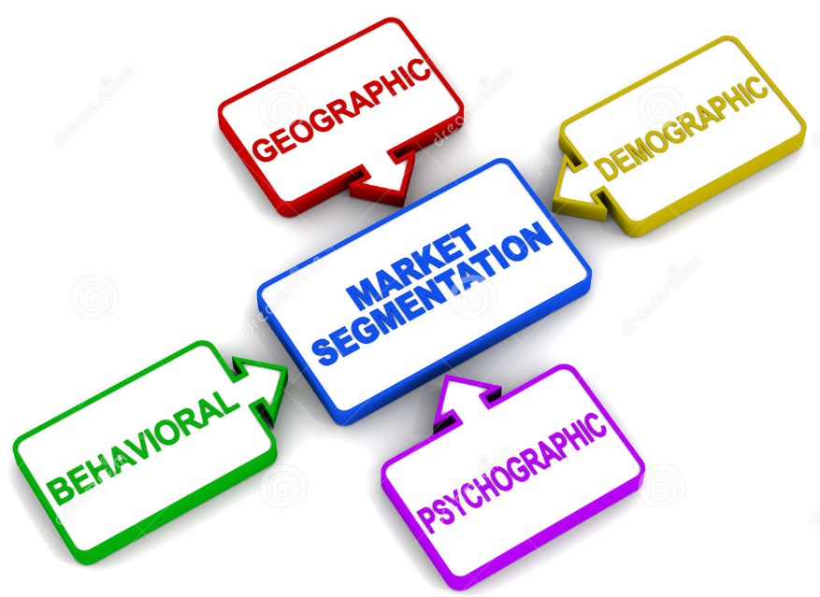
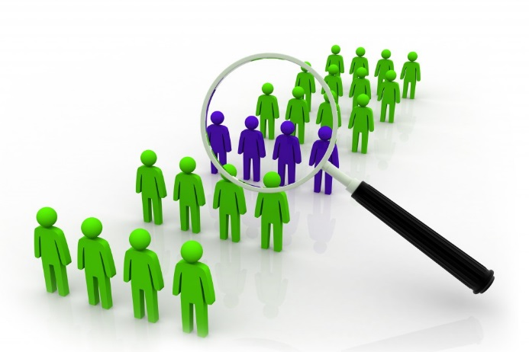
Market Segmentation
Target Markets are specific groups of people that a company is trying to reach, or “target”
Can be divided by any of the following categories
Target markets generally are created from a profile using a combination of all 4 categories.
Demographics
Age, Gender, Race, Income, Occupation, Grade, Education, etc.
Psychographics
Hobbies, personal preference, likes/dislikes
Geographics
Buying choices-ex. “I ONLY buy Coach purses”
Location
Behavioral

Slide 8
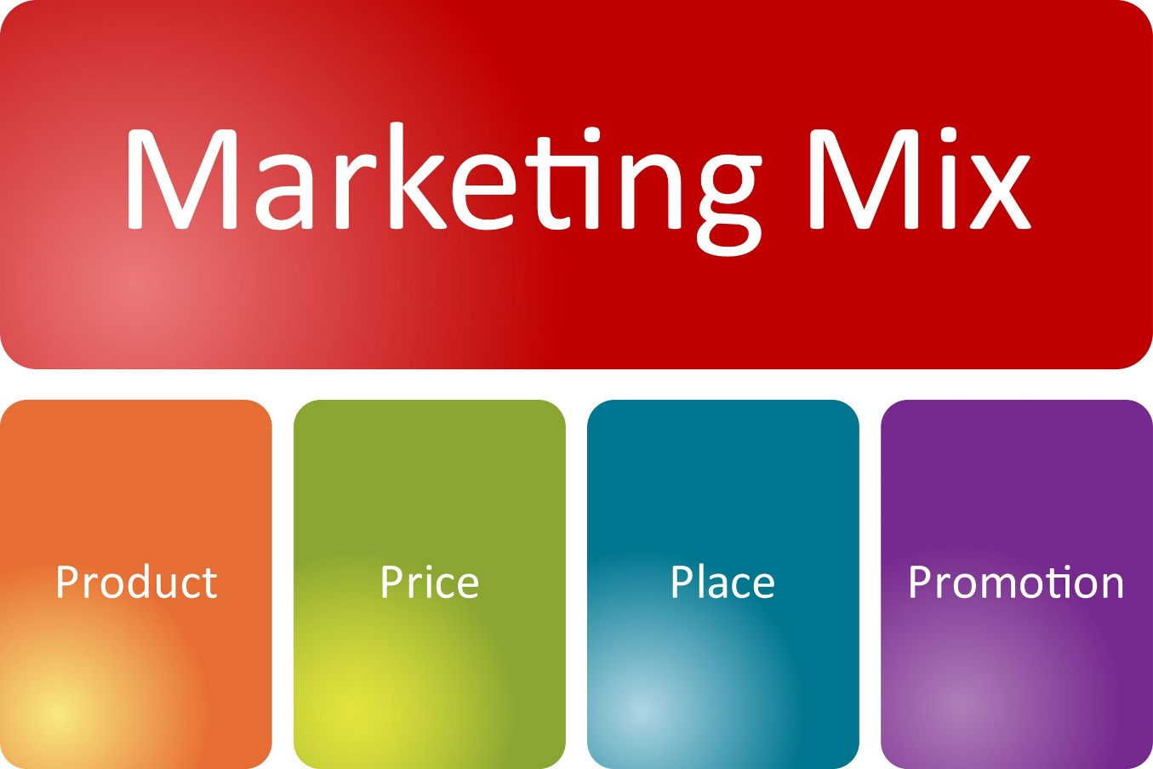
The Concept of Marketing
Companies decide how to satisfy their target customers
A marketing mix is a blend of features that satisfies a chosen market
The four major elements of a marketing mix are known as “the four Ps”
The 4 P’s are all areas where a company needs to plan strategies and decisions to improve chances of success

Slide 9
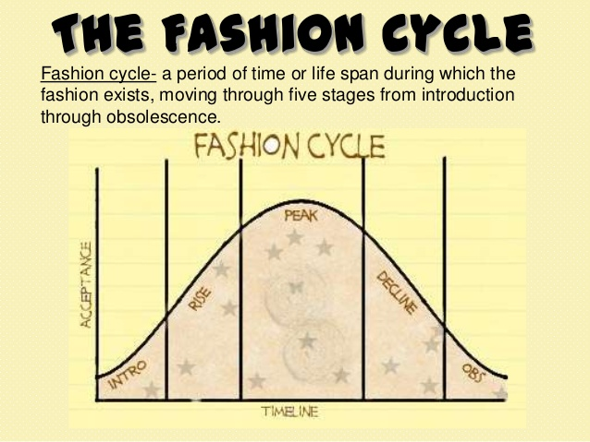
Product
The first marketing task is to determine the right products
Marketing people must decide what goods or services are in demand
The needs and wants of customers must be translated into desirable products
Social trends often provide a clue to the types of products that consumers will want
For example: Think of all the versions of the iPhone and Galaxy. Decisions had to be made about offering those products, how often to update them, whether to change the charging cord, updating the operating system, etc. Also keep In mind that companies also offer services, the same types of decisions and planning are needed for service oriented companies can be successful too! Since we are talking about fashion and trends move so quickly, this step is EXTREMELY CRITICAL to plan!

Slide 10
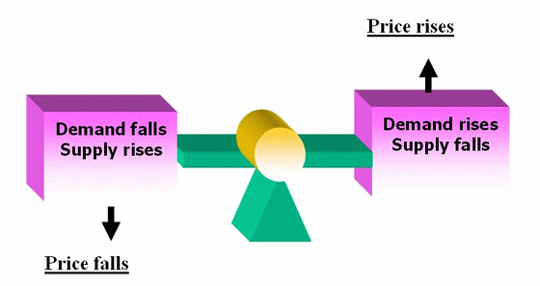
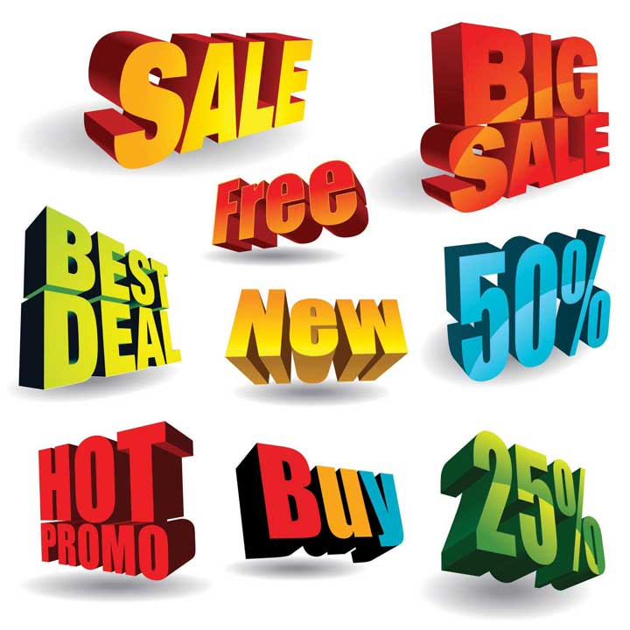
Supply and demand have a great effect on product pricing decisions
Low prices can sometimes maximize profits
The marketing triangle relates price to the amount expected to be sold
If the market demand quantity matches the price placement of the product on the marketing triangle, the highest total profit potential results
Price

Slide 11
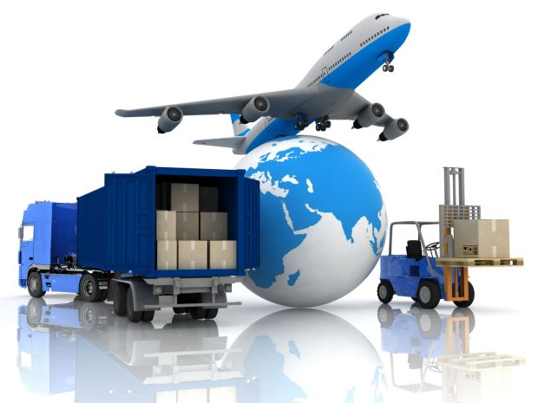
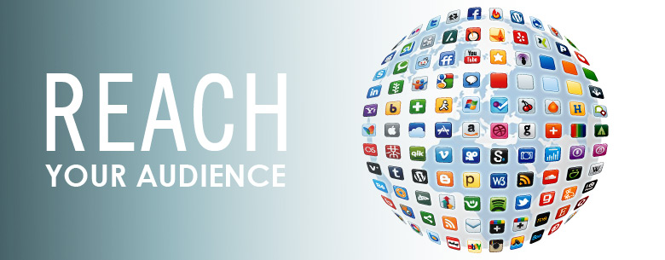
Place is how and where products are offered to customers
It represents distribution, or the best ways to get products to potential customers
Decisions must be made about the type of selling and delivery to use
Examples: department stores, discount chains, other types of retailers, mail-order catalogs, or websites, apps, social media, etc.
Place

Slide 13
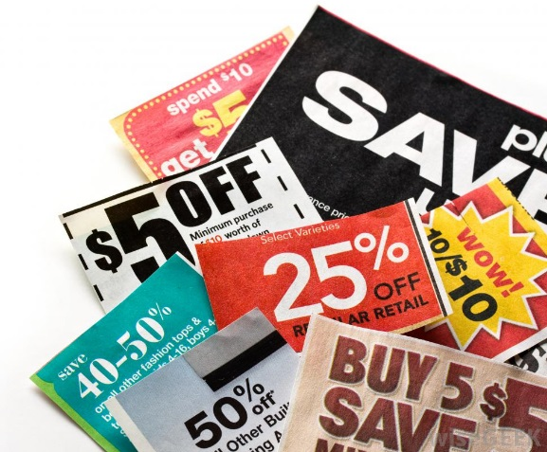
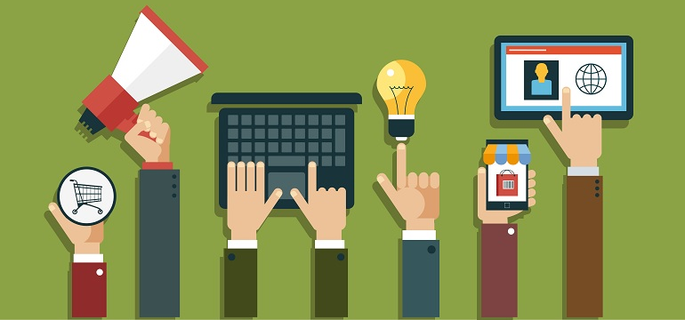
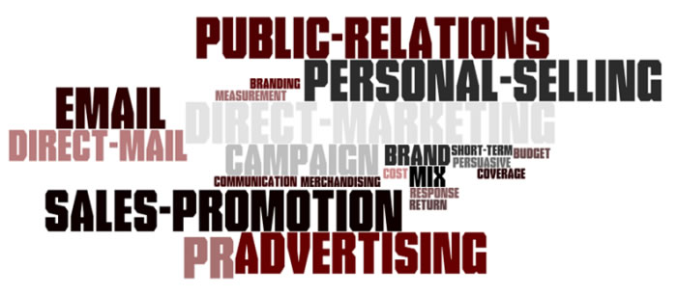
Promotion is nonpersonal activity that aids the sale of goods or services to an audience
It enhances the demand for specific brands of merchandise
It also helps retailers establish their identity to consumers
Promotional campaigns spread information to the marketplace and often determine the success of a marketing effort
Promotion

Slide 14
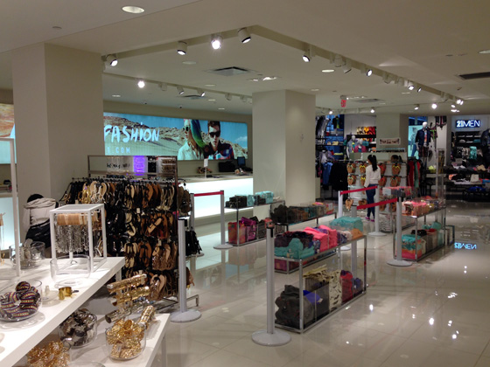
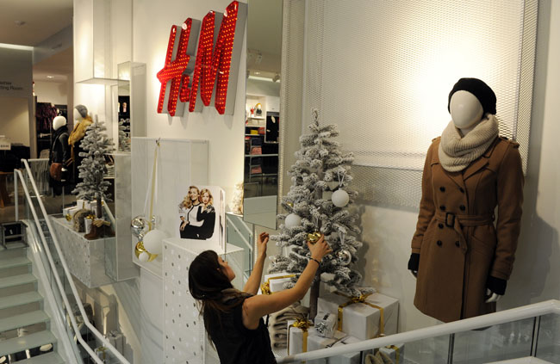
The Concept of Merchandising
Merchandising is the process through which products are obtained and promoted to the point of sale
This is done in response to the market demands indicated through marketing efforts
Merchandising tries to make a profit by matching the company’s products to existing markets

Slide 15
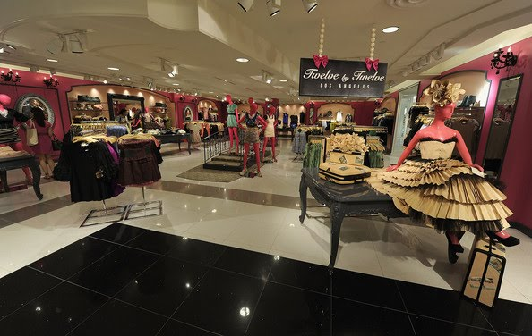
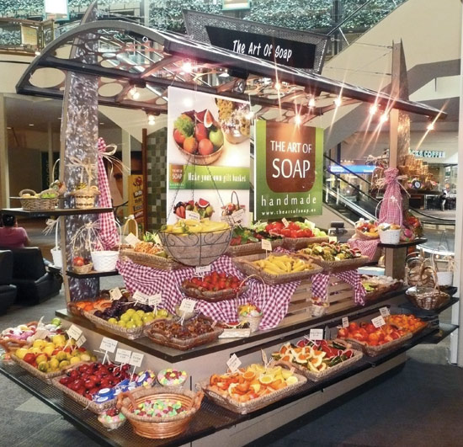
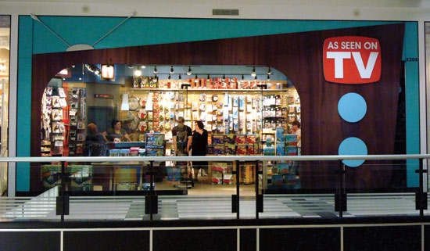
Merchandising involves varying degrees of planning, buying, and selling
Ideally, it creates the perfect blend of…..
All this work and planning…..just to remind you to………… BUY IT
Products, place, price, quantity, time and appeal

Slide 16
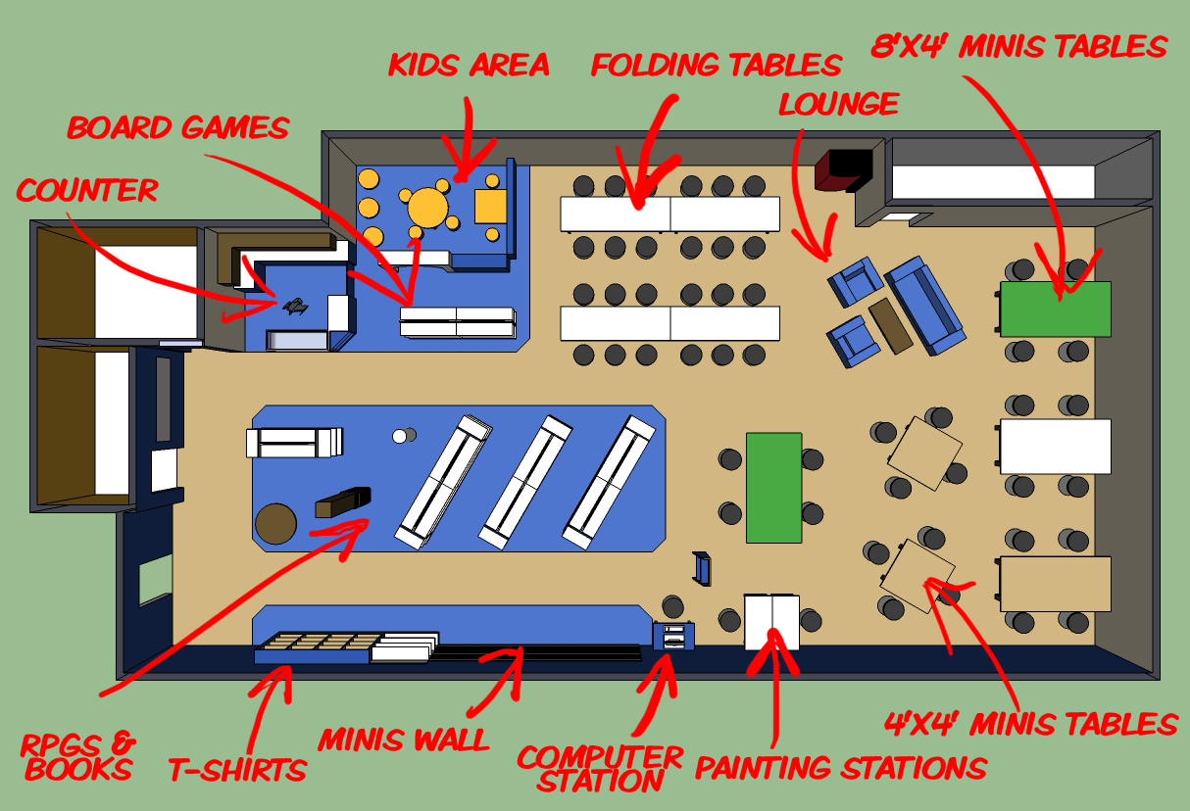
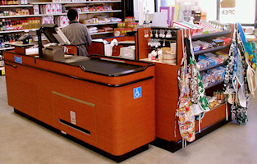
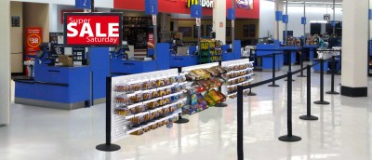
The Concept of Merchandising
Merchandising - done by all companies that deal with fashion goods
It also includes store layout, merchandise display, promotional events, and other activities
Retailing- concentrates almost entirely on the merchandising functions of planning, buying, and selling
People often refer to apparel retailing as “fashion merchandising”

Slide 17
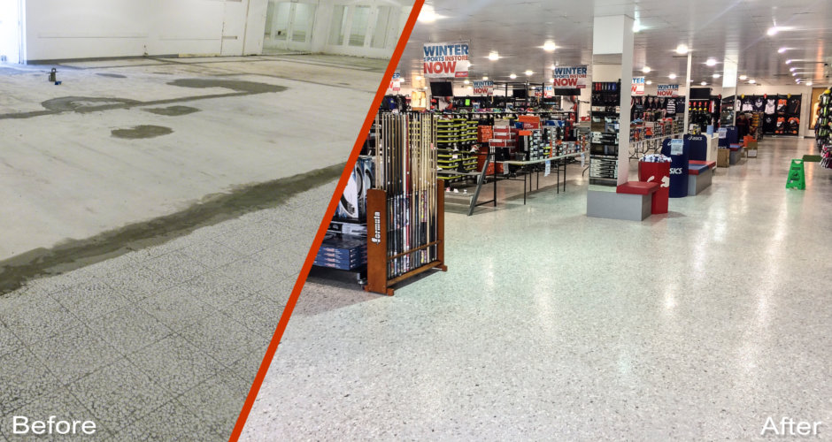
The Concept of Merchandising
Textile/apparel merchandising also has special challenges because of constantly changing fashions
Merchandisers must consider the costs of goods as well as all other costs of receiving, handling, promoting, and selling the goods
Successful retailing requires good marketing supported by effective merchandising

