Slide 1
1.0 Review Concepts

Slide 2
5 Principles of Fashion Movement
1.01
Consumers determine acceptance or rejection of fashions.
This is done with purchasing power. Consumers will buy what they want.
Price does not determine the acceptance of fashion.
Most fashion items will eventually be available at reasonable prices.
The amount of promotion created around a fashion does not predict its success.
Fashions tend to change or evolve gradually (evolutionary).
They do not change quickly. They are not revolutionary.
When fashions reach an extreme they will start to go in the opposite direction.
An extreme can only go so far then it changes.

Slide 3
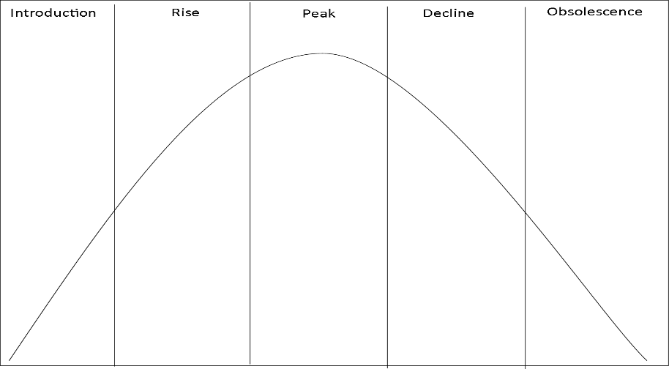
The Fashion Cycle
1.01
New,
expensive,
Few available
Red-carpet /Runway
All price levels available options
Peak of popularity
Lots of variety/ options/availability
Clearance/deep discounts
Making room for new trends
Items may be sent to closout stores like TJ Maxx Marshalls, Burlington, or Ross.
Prices can still be expensive
Still mainly celebrities/fashion leaders wearing the trend
Becoming popular, seen on TV and in magazines/internet
All price levels available options
Decline in popularity
Start to see sales
Walmart gets a version of this trend between peak and decline

Slide 4
Evolution vs Revolution
1.01
Fashion Movement
Many things can impact the evolution of fashion, such as :
Remember fashion changes little by little through the years.
Nothing in fashion is usually revolutionary, it is all a reimagined version and variation of a previous trend
Culture
Religion and how you grew up may have rules about what you can or cannot wear
Economic influences
How is the economy doing? Is unemployment high? Are companies closing?
Legal influences
Social influences
Think about how social media has changed fashion, and how we find out about new trends.
Technology

Slide 5
FIBERS
1.02
Natural—comes from plants (cellulosic) or animals (protein)
Wool—
comes from sheep, warm, sometimes soft, may be itchy
Silk—
comes from silk worms, made in Asia, expensive, soft, smooth, cool, has a sheen
Cotton—
comes from the cotton plant, grown in USA, soft, inexpensive, easy to take care of, cool
Flax (Linen)—
comes from the flax plant, grown in Europe, soft, expensive, wrinkles easily, special care
Leather—
comes from the hide (skin) of animals, cattle most popular source, soft, expensive, durable
Fur—
comes from the coat of animals, mink popular in USA, soft, expensive, durable, warm

Slide 6
FIBERS
1.02
Synthetic (manufactured/manmade)made from chemicals & other substances
Polyester—made from oil, petroleum, and plastic bottles; inexpensive, blends well, soft
Nylon—first fiber to be made from chemicals, stretchy, soft, very light weight
Rayon—soft, light weight
Acetate—synthetic for silk, soft, not as expensive as silk
Acrylic—synthetic for wool, soft, not itchy, not as expensive as wool
Spandex—blends well, stretchy, snug fit

Slide 7
Classifications
1.03
Menswear
Jewelery & Accessories
Furnishings****
Sportswear vs Activewear
Work clothing Formal wear, and outwewear
Tailored Clothing
Costume- Cheap- Claires
Bridge-Real, but average quality and price- Macys/Department Store
Fine-Expensive & high quality materials- Kay Jewlers, Jared, Tiffany’s
Womenswear
Sportswear vs Active sportswear
dresses outwerwear
Intimate apparel
maternity

Slide 8
Sizing
1.03
Mens/Boys
Women/Girls
Boys- Slim, plus and Husky sizes 3-22
Tailored Clothing
Short – 5’5” to 5’7”
Regular – 5’8” to 5’11”
Long – 6’ to 6’3”
Extra Long – 6’4” and over
Sizes usually by measurements or SMLXL
Waist x Inseam= 38x32
Girls- Slim, plus and Husky sizes 3-16
Juniors- Odd Sizes- Short waist, not made for curves
Misses- Even Sizes- Fuller Figured, but not plus size 0 to 20
Petite- Under 5’4, will generally have P
Womens- Includes plus sizes, generally has W
Tal is for over 5’8
Double ticketed- 9/10 – 2 sizes on ticket

