Slide 1
5.02
Understanding retail selling processes of the fashion industry

Slide 2
What are the steps of the retail process?
Approach
Customer Classification (Determining Needs
Casual Lookers
Undecided Customers
Decided Customers
The Sale (Presenting the Product, Handling Objections)
Responsive Selling
Suggestive Selling
Add-Ons and Special Offers
Questioning
Presenting
Trial Confirmation (Handling objections)
Closing

Slide 3
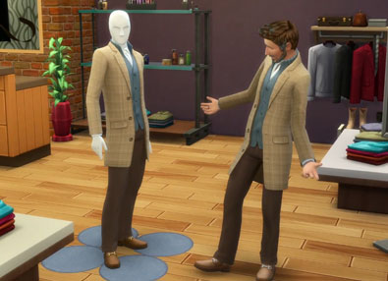
The Approach
Approach – how you initially greet the customer
When approaching a customer, you do not want to overwhelm them. Just asking “Hello, how are you?” or “Let me know if I can help with anything,” will lead you into the sale.
Bottom line: if you want to stand out in a crowded market where too many people have too many choices of who they do business with, a greeting of “good” trumps the greeting of buy my widget every time.
- Bob Phibbs
How To Approach A Customer

Slide 4
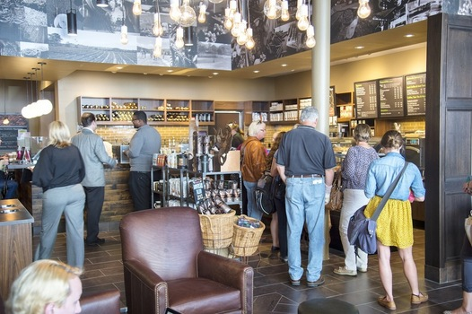
Customer Classification
Casual lookers - classification of customers
who are simply browsing or killing time
Decided Customers - customers that know exactly what they want
Undecided Customers – classification of customers that need an item, but seek pertinent information about products

Slide 5
Responsive Selling
Responsive selling – responding to the customer’s presence rather than going out to find customers
This is done by salesclerks and sales associates.

Slide 6
Suggestive Selling
Suggestion selling is a method of increasing sales by adding to the customers’ original purchase.
By using suggestion selling you can convince the customer to buy more items than what they came for or trade up to more expensive items.
Add-ons – additional merchandise items such as related items to create complete outfits
“This necklace goes great with this outfit!”
Special offers – when an additional item can be obtained as a result of purchasing an item
“Today if you buy one necklace you can get any other piece of jewelry half-off!”

Slide 7
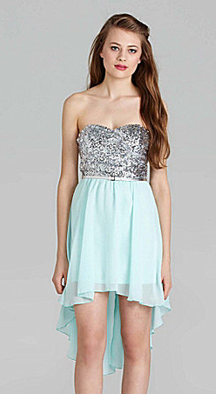
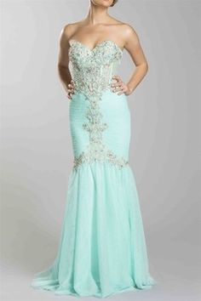
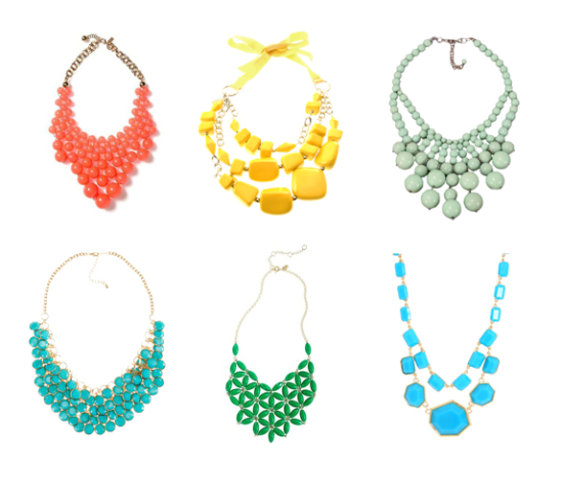
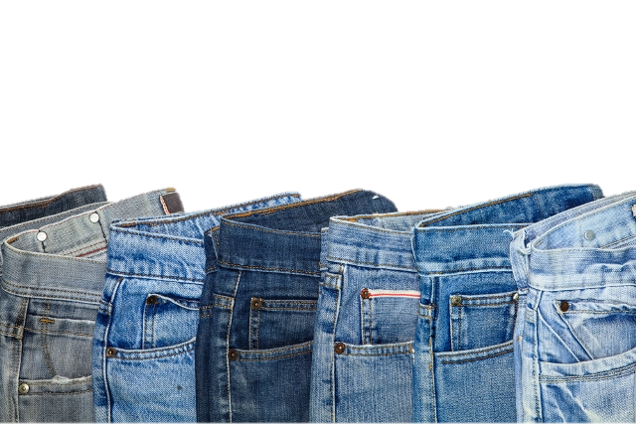
Cont.
Trading up – obtaining larger sales by selling higher-priced, better quality merchandise to customers
“Try this dress on first.”
More-than-one selling – suggestive selling of
more than one of the same or similar items
“Different colors to match every outfit!”

Slide 8
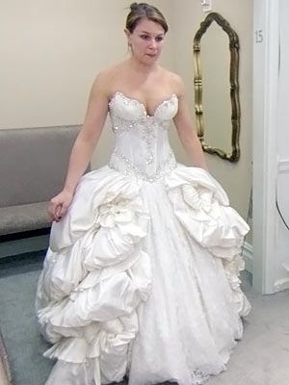
Objections
Objection – feelings/concerns/disapproval
It is all part of the sales process.

Slide 9
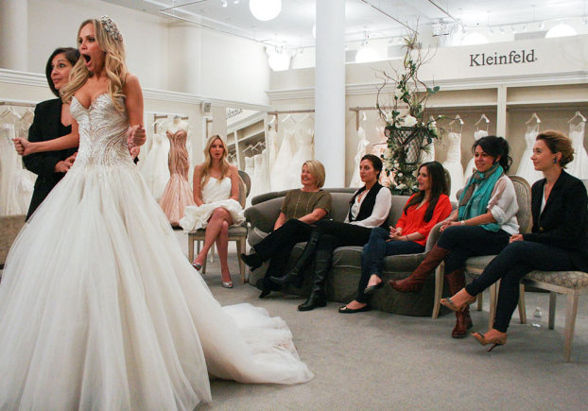
Benefits
Benefit – favorable outcomes received
Product features – physical characteristics of items

Slide 10
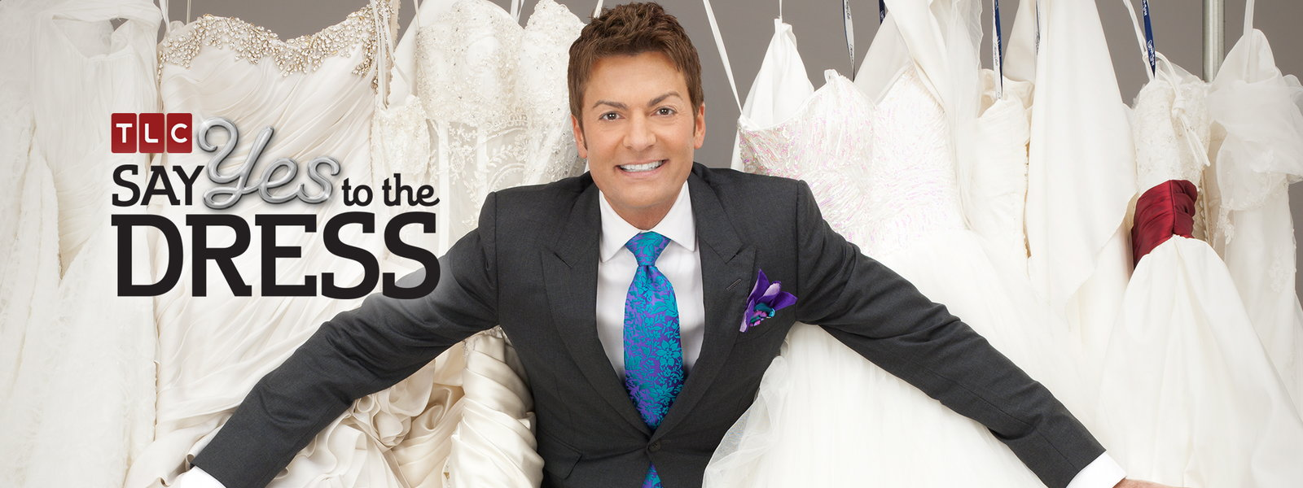
Benefits
Say Yes To The Dress
Veil was a benefit
Product Features – sparkly
Also an add-on
Decided Customer

Slide 11
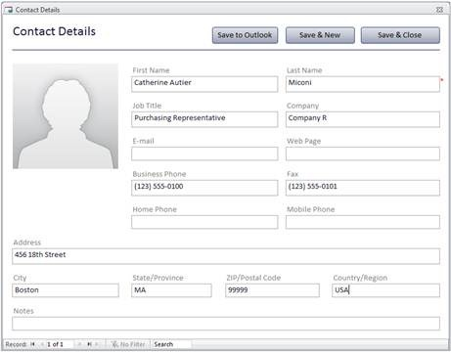
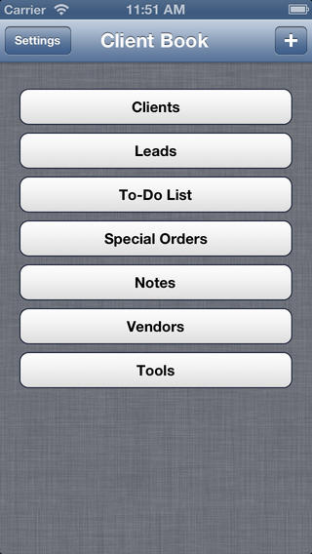
Clients
Normally retailers will keep a detailed list about their clients, this is called a:
Client book – a salesperson’s book of customer’s names, and personal information, important dates
Pre-selling – maintaining contacts with previous customers to start the selling steps all over again
Customers always have questions, so you always need a
Solution – answer to a problem

Slide 12
The Process
Open-ended questions – questions that require multiple- word answers rather than merely a yes or no
Presentation – is the process of presenting a topic to an audience.
Selling - is offering to exchange an item of value for a different item. The original item of value being offered may be either tangible or intangible.
Trial confirmation - a salesperson’s questions to a customer to get an indication of what needs to be done to close the deal

Slide 13
The Close
Close – getting the commitment from the customer to buy the merchandise

