Slide 1
5.01
Understanding the impact of customer service in the fashion industry

Slide 2
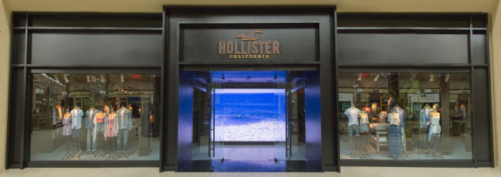
Customer Service
Customer Service is the total of all enhancements offered to customers.
Directly related to the sale of goods

Slide 3
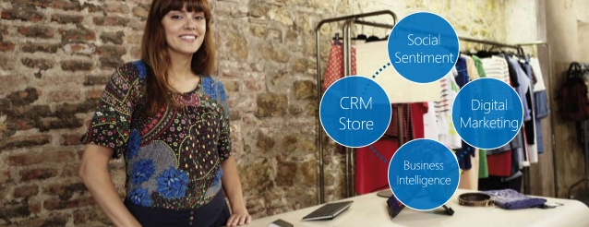
Customer relationship management
Customer Relationship Management is the merging of database information technology with customer service to analyze customers, respond individually to their needs and build and maintain lasting relationships

Slide 4
Service Quality
Service Quality is how well services are preformed.
Shoppers who are willing to pay more, also expect more.
Friendly, polite, approachable, trustworthy, reliable.
Hassle-Free shopping

Slide 5
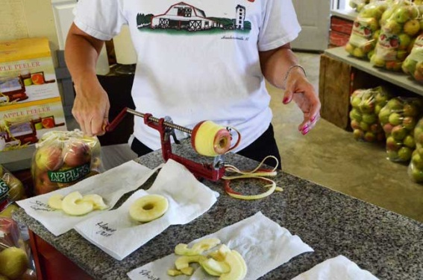
Service Features
Complementary tea, cookies, etc,
Walmart
Contests
Journey's
Call buttons in fitting rooms
Victoria Secret
In-store events
Kellogg’s Mariachi Band at Walmart
Product demonstrations
Grandad’s Apples
Interest-free credit
Best Buy
Page 364 in textbooks

Slide 6
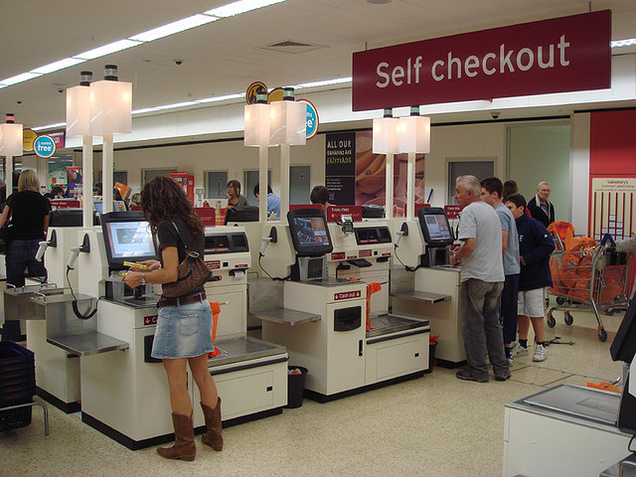
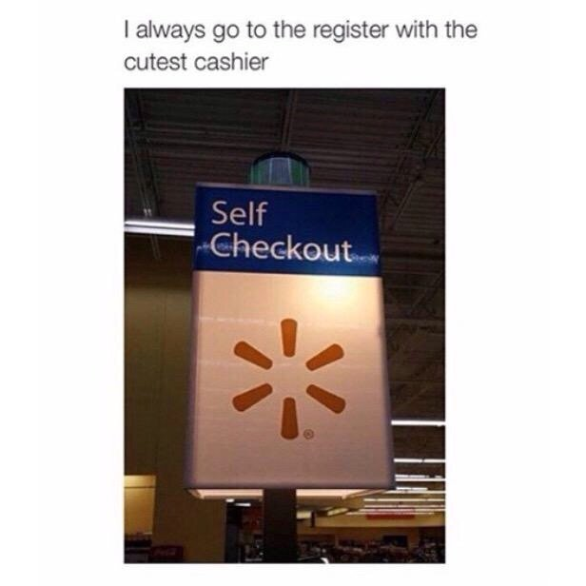
Self-Service Retailing
Self-Service Retailing uses price positioning.
Customers locate, wrap, compare, and checkout items themselves.

Slide 7
Service Levels
Self-Service
Limited Service
Full Service
Medium amount of services
Goods with some selection and comparison features
Very few services
Low Prices
Staple goods
Convenience items
Many services
Upscale fashion goods and specialty items
Characteristics
Discount stores
Warehouse clubs
Mail-order retailers
Vending machines
Supermarkets
Chain stores
Department stores
Door-to-door sales
Upscale department stores
Specialty stores
Store Types

Slide 8
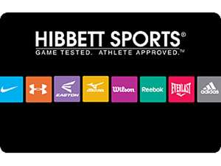
Loyalty programs
Loyalty programs are structured marketing strategies designed to encourage customers to continue to shop at or use the services of businesses associated with each program.
There are large numbers of such programs in existence covering most types of business, each one having varying features, and rewards schemes.
7 Loyalty Programs That Add Value

Slide 9
Loyalty Programs Link
http://blog.hubspot.com/blog/tabid/6307/bid/31990/7-Customer-Loyalty-Programs-That-Actually-Add-Value.aspx

