Slide 1
Understand The Use Of Technologies In Fashion Merchandising And Marketing
FM 3.02

Slide 2
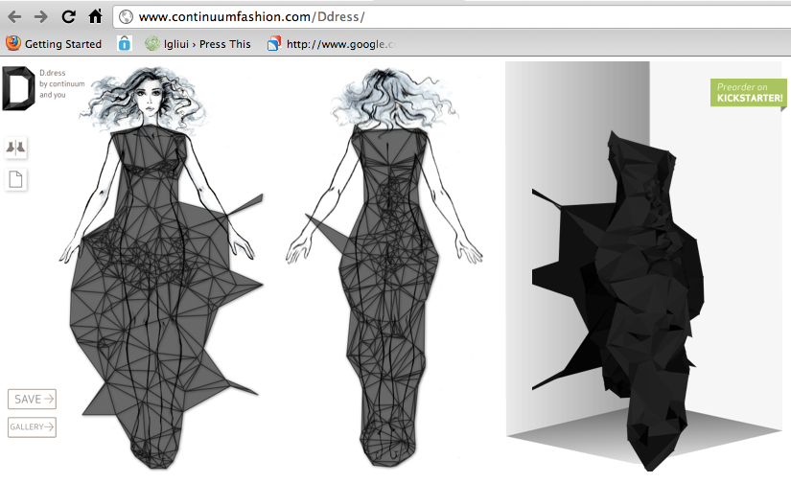
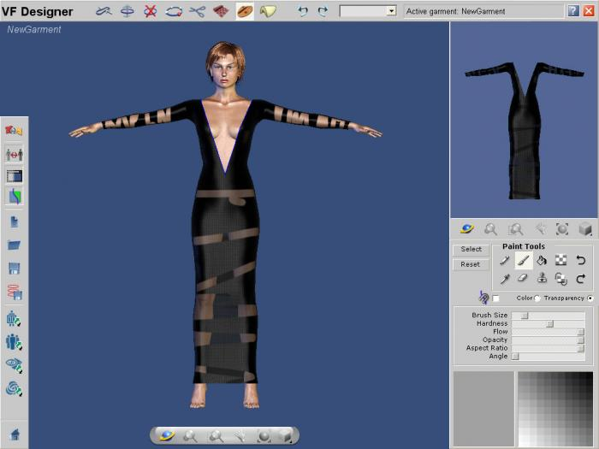
Marketing Technology Terms
Computer aided design (CAD)
A computer system used for designing textiles, apparel, &other products.

Slide 3
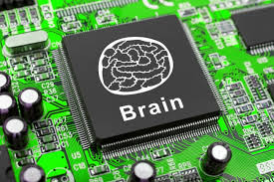
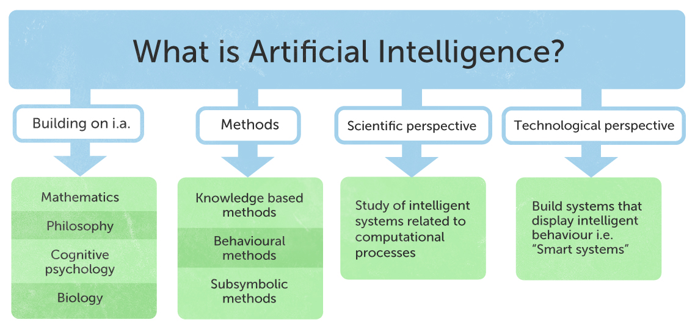
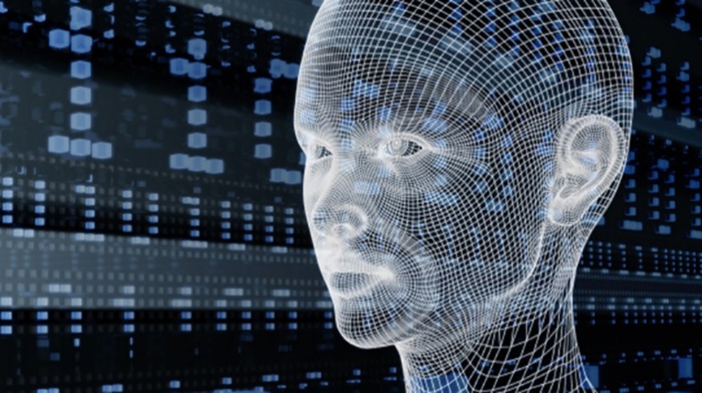
Marketing Technology Terms
Artificial intelligence
Computer systems that display behavior that would be regarded as intelligent if it were observed in humans

Slide 4
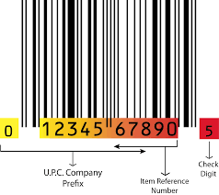
Marketing Technology Terms
Bar code-Stores may have their own
Product codes with dark bars and white spaces of varying widths used on merchandise tags for electronic identification and collection of product data.
Universal product code (UPC)
Standard bar code, that includes numbers as well as bars and spaces. (12 digits)
Point of sale (POS)-Cash Register System will connect with inventory to keep accurate records
Merchandise data collected electronically when consumer purchase transactions are recorded.

Slide 5
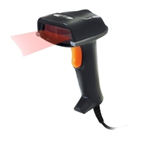
Marketing Technology Terms
Electronic optical scanner
Electronic light beam readers that feed bar code information to computers
Wireless data collection done with “smart labels and electronic product codes through airwaves

Slide 6
Marketing Technology Terms
Click stream data
Sequence or 'flow' of mouse clicks or keystrokes which a user makes in navigating through webpages or websites.
Web advertisers use the clickstream record to determine the user's interests and preferences in order to custom-tailor their advertisements.
Clienteling
Collecting information about customer experience and purchases over time, and using that data to increase sales and improve shopping experience

Slide 7
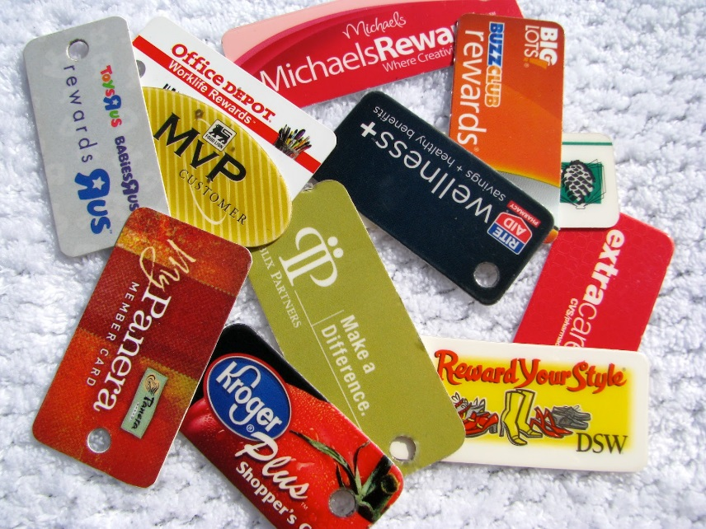
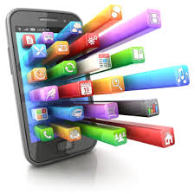
Marketing Technology Terms
Information management
Activities that generate an orderly and timely flow of relevant information to support business activities
Loyalty program-
A system of rewarding a retailer’s best customers to encourage repeat sales, using consumer specific data
Mobile apps
A software application developed specifically for use on small, wireless computing devices, such as smartphones and tablets, rather than desktop or laptop computers.

Slide 8
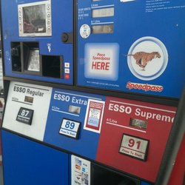
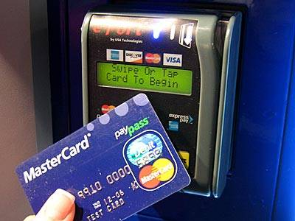
Marketing Technology Terms
Radio frequency identification (RFID)
Wireless data collection done with “smart labels and electronic product codes through airwaves.
Social media
Personal content created and spread via electronic technology for interaction and sharing of information.

Slide 9
Technological Transformation of Information Management for Merchandising & Marketing
Retailers are reinventing in-store shopping.
Customers want to see, try, and feel merchandise before making a purchase.
Connecting brick-and-mortar and digital interactions to create unique, highly personalized in-store experiences.
Mobile apps are giving retailers the ability to send information, coupon offers, and suggestions to a shopper, which can encourage cross-category promotion and impulse purchasing.

Slide 10
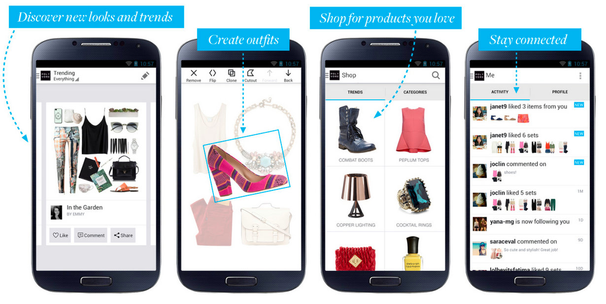
Technological Transformation of Retail in The Fashion Industry
Mobile apps are the single greatest contributor to changing the overall shopper experience at retail
Retail items can now be sold through multiple channels (stores, catalogs, internet, and mobile apps), it’s called multi-channel retailing
https://www.youtube.com/watch?v=ZxrzIXkPycs&feature=youtu.be

Slide 11
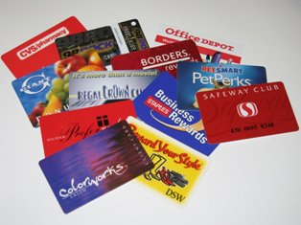
Technological Transformation of Customized Products and Services in the Fashion Industry
Next generation loyalty systems will drive a new level of “tailored shopper interaction” rewarding both normalized patronage as well as incremental spending
Mass customization allows for design and manufacture of customized products to meet customer needs at mass production costs and speed.

Slide 12
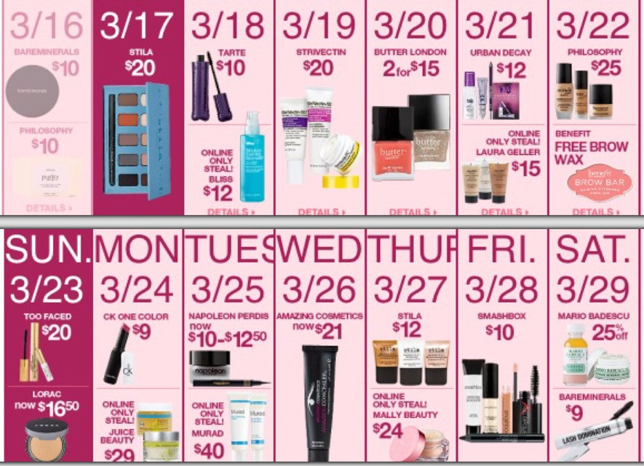
Flash Sales
Flash sales allow for building brand loyalty while selling surplus stock in a short period of time. It is economical and profitable for retailers.
Provide a small window of opportunity to take advantage of sales

