Slide 1
1.03
Understand the Categories of Fashion Merchandise

Slide 2
Vocab
activewear, double-ticket sizing, dresses, evening and bridal, foundations, intimate apparel, junior, lingerie, loungewear, maternity,, misses, outerwear, petite, sleepwear, sportswear separates, suits, swimwear/beachwear,

Slide 3
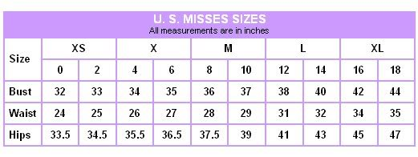
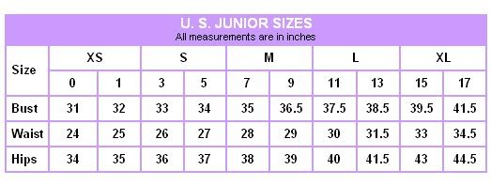
Women’s Size Classifications
Misses
Fuller figure, longer waisted
Sizes even numbers 0 to 20
Juniors
A size, not age
Youthful look; slender and shorter waisted
Sizes odd numbers 0-15

Slide 4
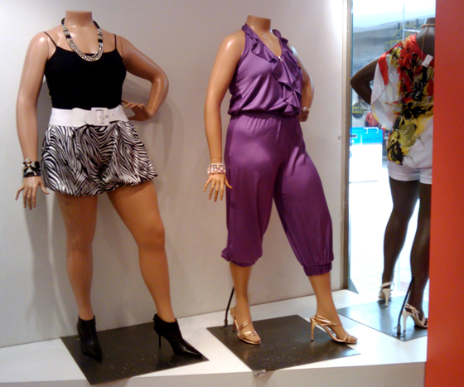
Women’s Size Classifications (Cont’d)
Petites
Shorter women usually 5’4” and under
Sized using a “P” after the number
Women’s (plus and half sizes)
Larger fuller figures of average height
Sized using a “W” after the number

Slide 5
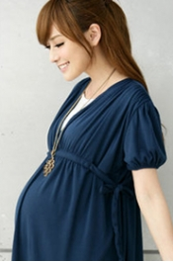
Women’s Size Classifications (Cont’d)
Maternity
Garments that allow for expansion
Available in a range of womenswear sizes in the categories listed above
Double ticketed: Apparel marked with two sizes (9/10)

Slide 6
Review
How can you tell the difference between juniors and misses clothing sizes?

Slide 7
Women’s Apparel Merchandise Classifications
Dresses – one-piece or two-piece
All occasion, daytime, and sundresses
Evening, bridal, and after-five gowns, cocktail dresses, and formal wear
Sportswear- *does NOT mean athletic wear*
Pants – capri/cropped, shorts, casual, and dress
Skirts – a-line and pencil
Sweaters – turtleneck, cardigan, and pullover
Tops – blouses, knit tops, shirts, tanks, and tees
Suits – jackets with pants and/or skirt
Jeans and other denim wear – 5-pocket, low rise, boot cut, stretch, skirts, and shirts

Slide 8
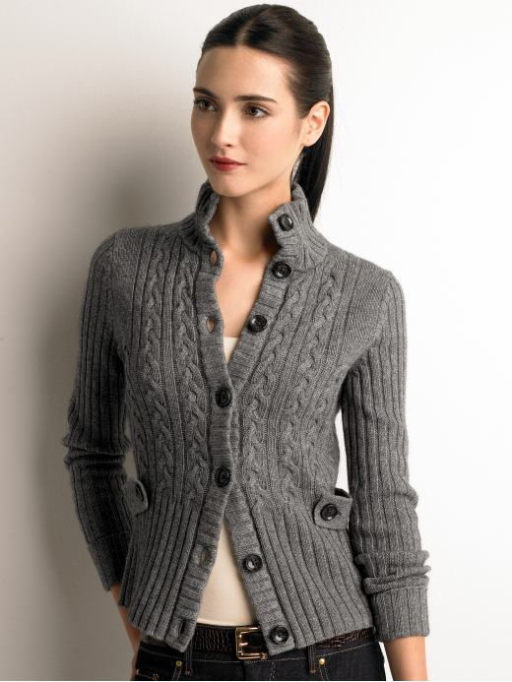
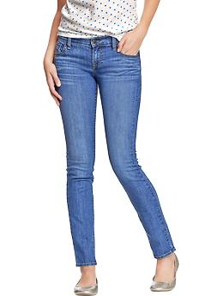
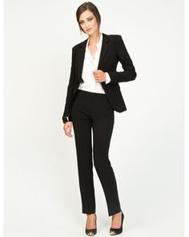
Sportswear

Slide 9
Women’s Apparel Merchandise Classifications (Cont’d)
Active sportswear *This IS athletic wear*
Swimwear, beachwear, exercise attire, dancewear, and warm-up suits

Slide 10
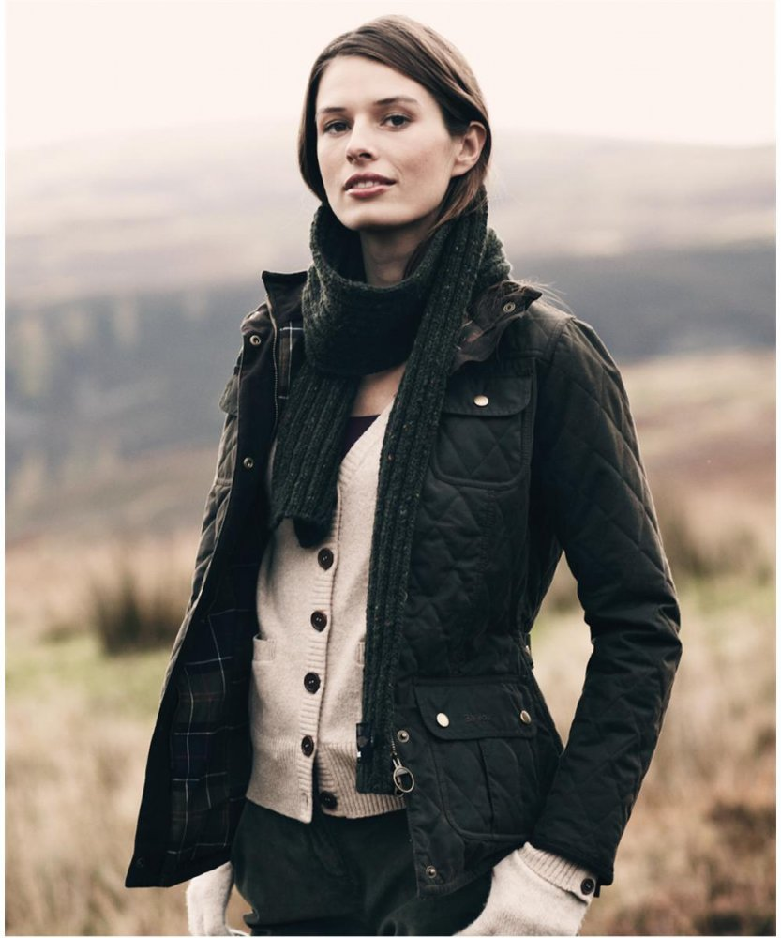
Women’s Apparel Merchandise Classifications (Cont’d)
Outerwear
Coats – all weather, leather, trench, and rain gear
Jackets – jackets, blazers, and casual
Intimate apparel
Foundations (bras and panties), camisoles, boyshorts, tanks, thongs, and shapewear

Slide 11
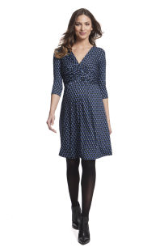
Women’s Apparel Merchandise Classifications (Cont’d)
Sleepwear – lingerie, loungewear, robes, and pajamas
Maternity – apparel that will expand

Slide 12
Men’s Apparel Sizes and Merchandise Classifications
Vocab
active sportswear, dual sizing, footwear, furnishings, heavy outerwear, inseam, menswear, miscellaneous wearing apparel, short run, sportswear, suit separates, tailored clothing, and work clothing

Slide 13
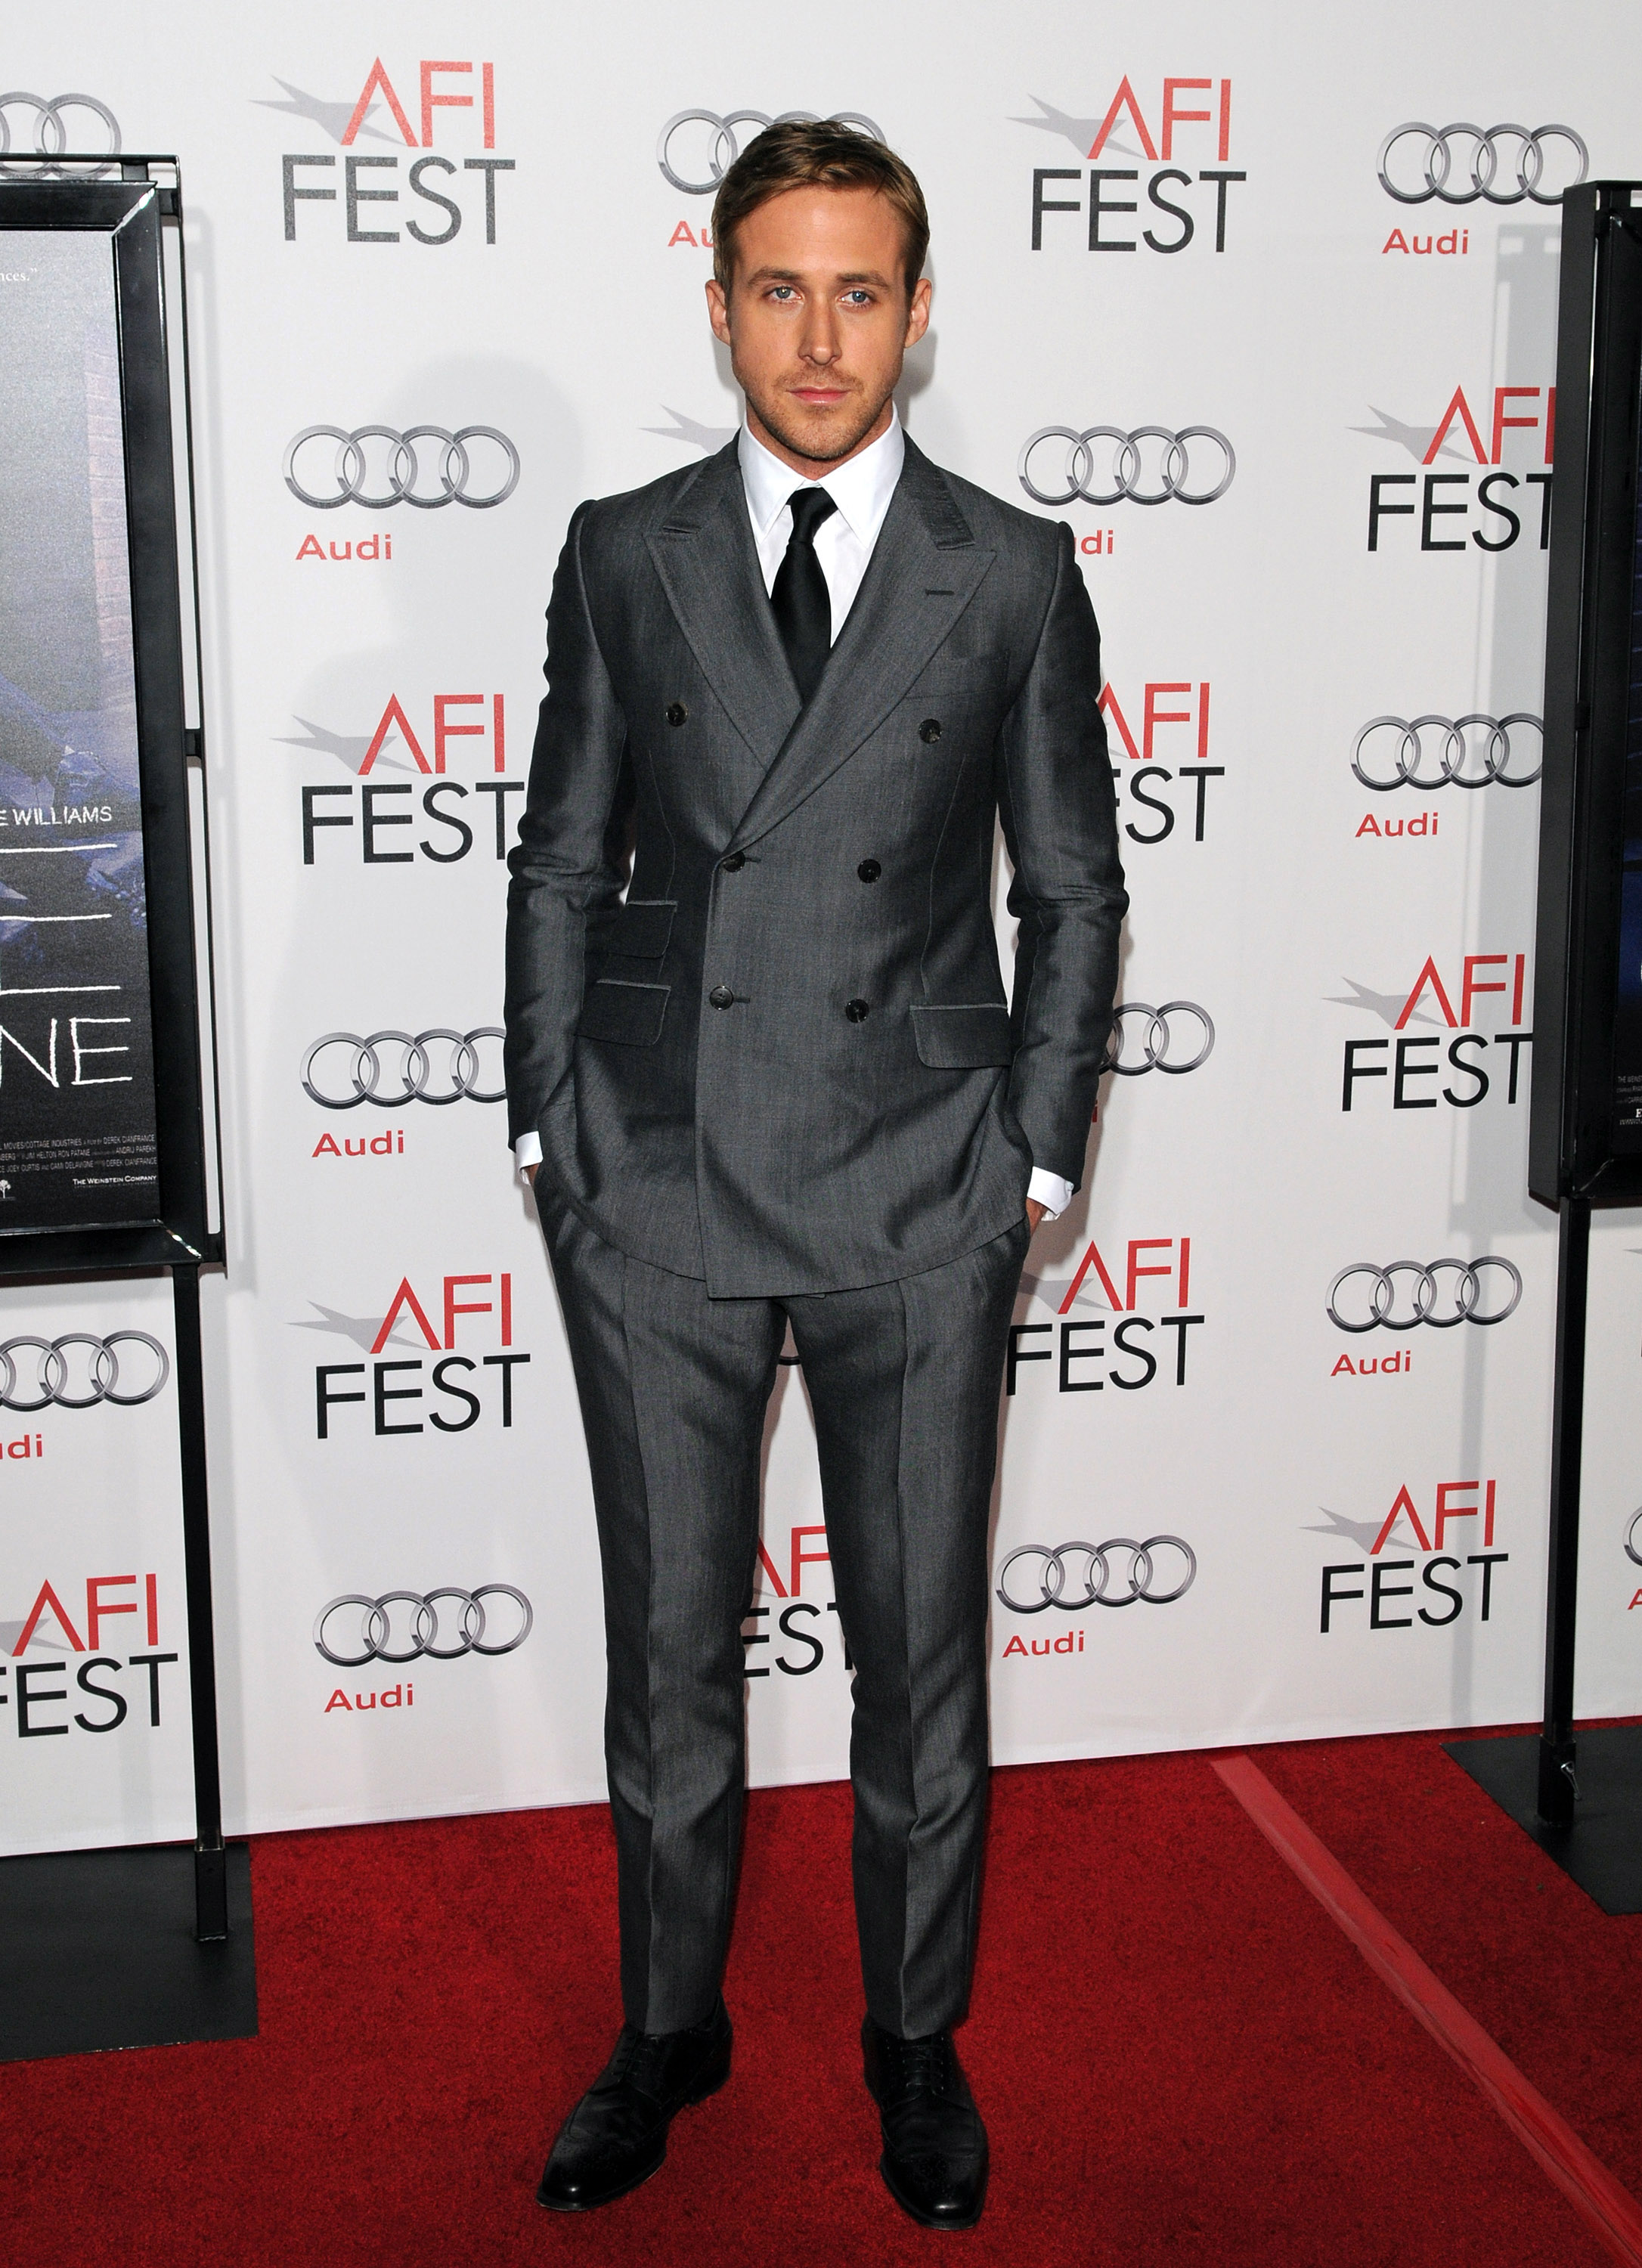
Men’s Apparel Sizes and Merchandise Classifications
Tailored clothing:
Suits usually sized by chest measurement (36-44) and length
Short – 5’5” to 5’7”
Regular – 5’8” to 5’11”
Long – 6’ to 6’3”
Extra Long – 6’4” and over
Extra Large – size 50 and over and six feet or taller
Portly – large sizes and 5’5” to 6’
Athletic cut – expanded chests and narrowed waistlines

Slide 14
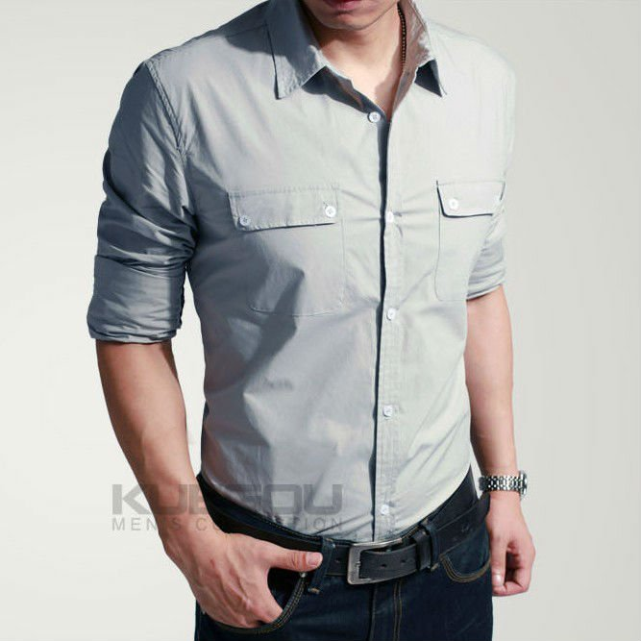
Men’s Apparel Sizes and Merchandise Classifications
Shirts
S, M, L, XL, XXL, 3XL, 4XL for sports shirts and sweaters
Neck width and sleeve length for dress shirts. Example: 16” neck size x 32” sleeve length
Only long-sleeved shirts are considered dress shirts.
Ties are only worn with dress shirts.

Slide 15
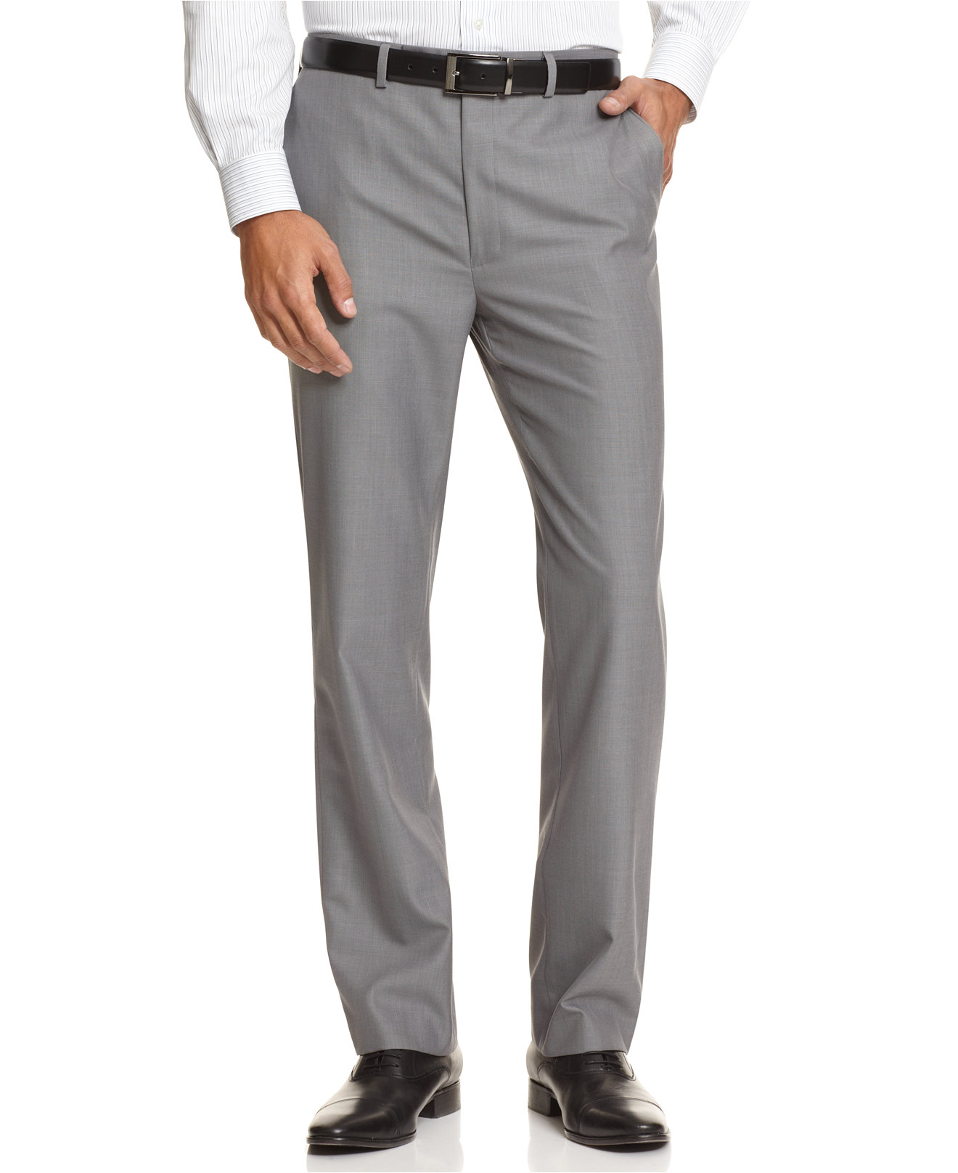
Men’s Apparel Sizes and Merchandise Classifications
Pants
Waist size and inseam length. Example: 34” waist x 36” length
Some men’s pants may come in S, M, L, XL, and XXL.
Some dress slacks are left unhemmed to be finished by the store’s tailor.

Slide 16
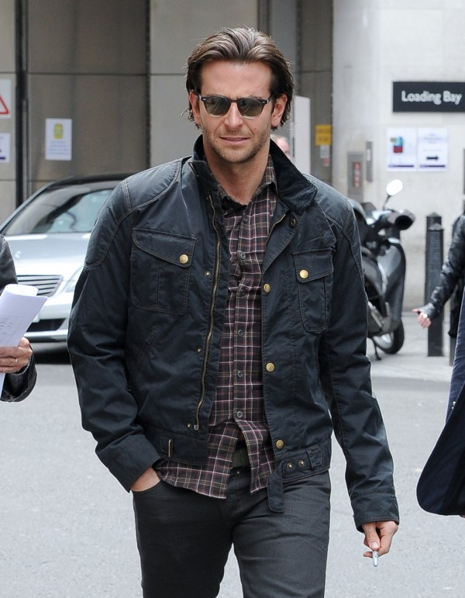
Men’s Apparel Sizes and Merchandise Classifications
Sportswear (again, not athletic wear)
Streetwear (Urbanwear) – Sean Jean, Crooks & Castles, Rocawear, Nixon, G-unit
Jeans – boot cut, carpenter, and loose and baggy
Shirts – casual (long-sleeved, short-sleeved, polo, and knit)
Pants – casual, cargo, utility, dress, and khaki
Sweaters – cardigan, pullover (crewneck, V-neck), and turtleneck

Slide 17
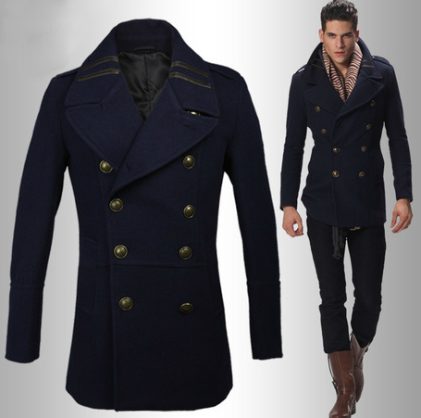
Men’s Apparel Sizes and Merchandise Classifications
Tailored clothing – overcoats, suits, sport coats, and blazers
Outerwear – Coats, parkas, jackets, and snow wear

Slide 18
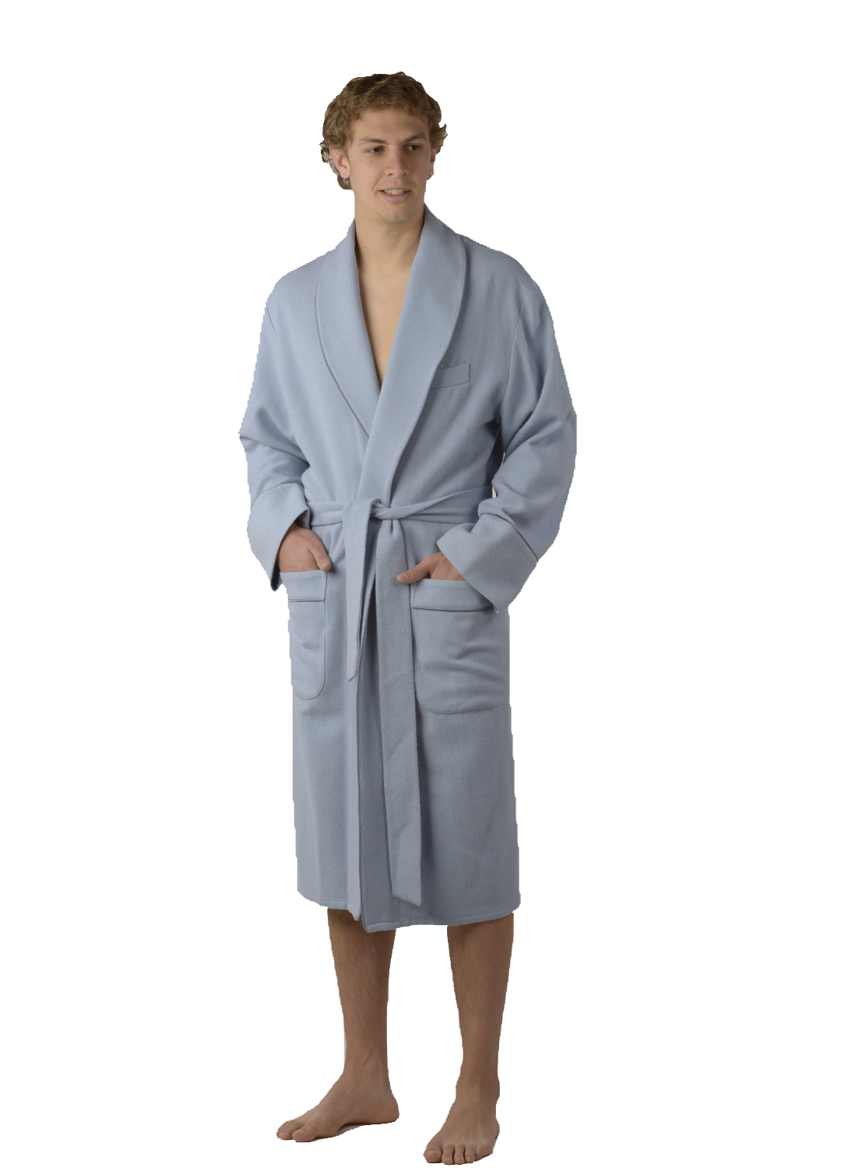
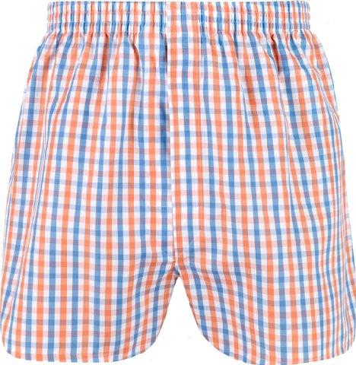
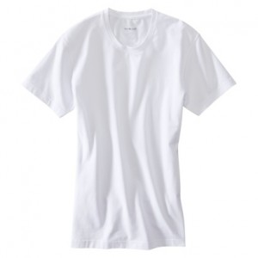
Men’s Apparel Sizes and Merchandise Classifications
Furnishings
Dress shirts, ties, and socks
Underwear – boxers, boxerbriefs, briefs, and t-shirts
Sleepwear – robes and pajamas

Slide 19
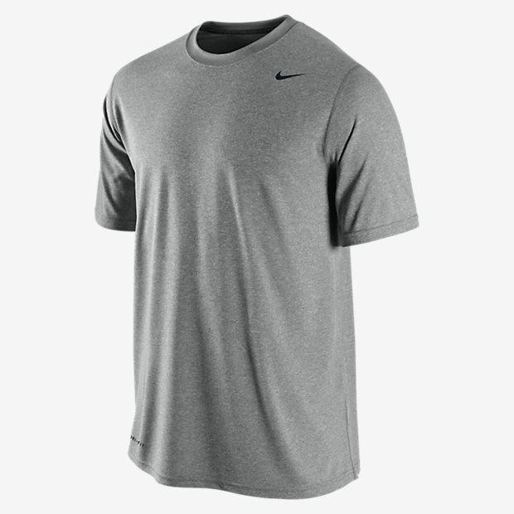
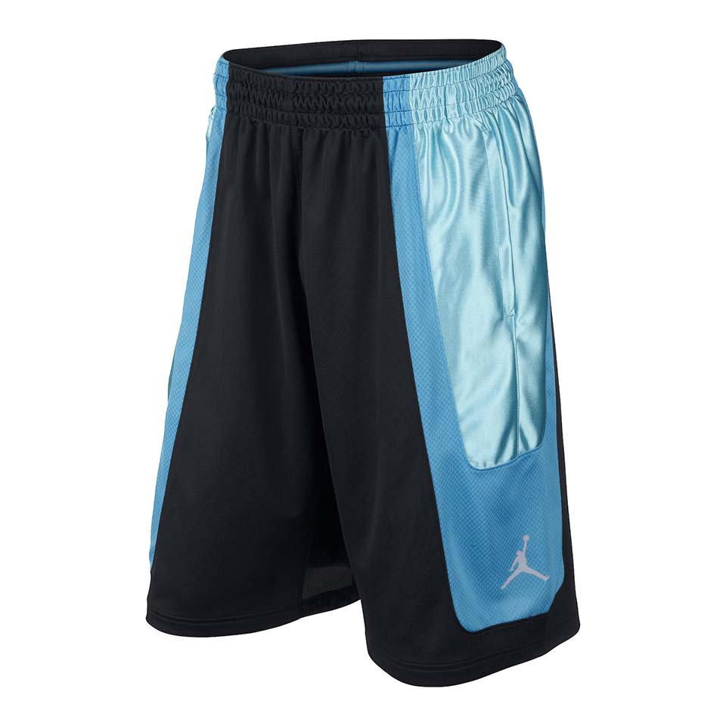
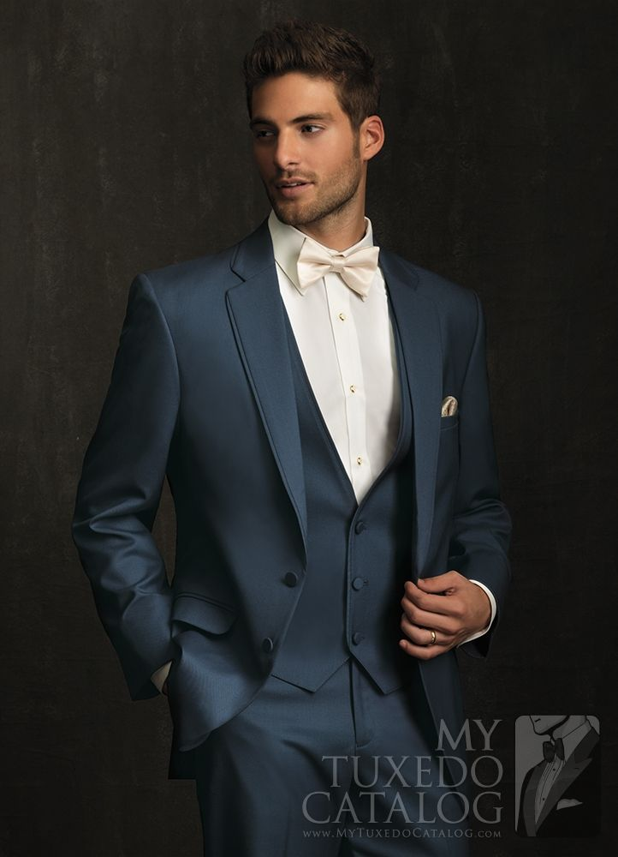
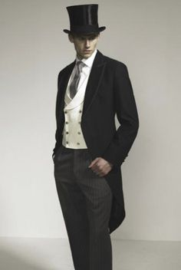
Men’s Apparel Sizes and Merchandise Classifications
Active wear –( This IS athletic clothing) Hoodies, tees, warm-ups, jerseys, fleece pants, and shorts
Work clothing – work shirts and pants, overalls and jeans, and uniforms
Formal wear – wedding attire, tuxedos, and dinner jacket

Slide 20
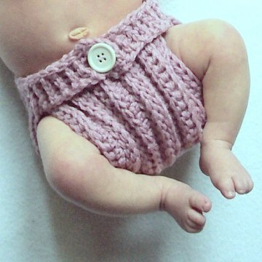
Size Classifications and Apparel for Infants, Toddlers, and Children
Infants
Newborn, 0-24 months (3-6 months, 6-12 months, 12-18 months, 18-24 months)
Newborn, small, medium, large, and extra large

Slide 21
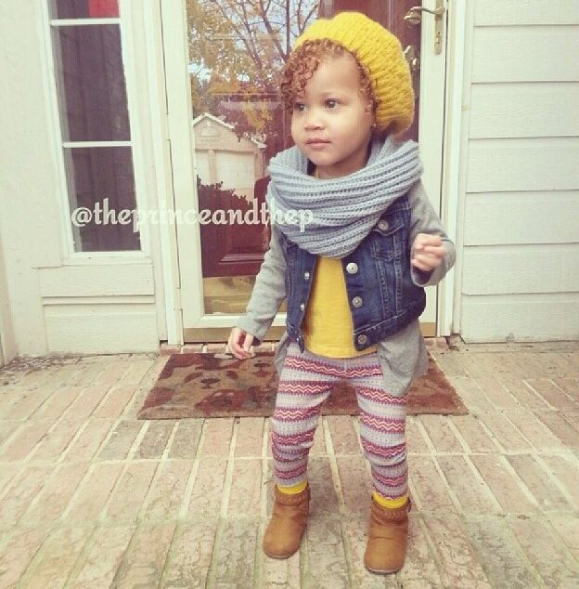
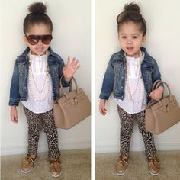
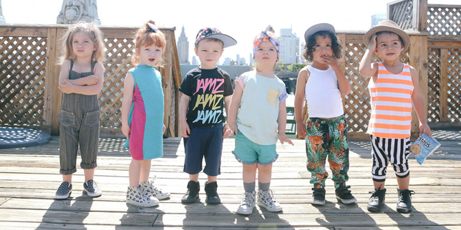
Size Classifications and Apparel for Infants, Toddlers, and Children
Toddlers – (crawling and walking), 2T-4T

Slide 22
Size Classifications and Apparel for Infants, Toddlers, and Children
Children
Preschool
Slim, regular, girls and boys, 3, 4, 5, 6, 6X, and 7
Small (2-3), medium (4-5), and large (6-7)
Older
Girls sizes 7 through 16 and also slim or plus sizes
Boys sizes 8 through 22 and also slim or husky sizes

Slide 23
Size Classifications and Apparel for Infants, Toddlers, and Children
Infants – babies and toddlers younger than three years old
based on comfort and practicality
Fabrics should be soft, absorbent, shrink resistant and durable with great washability.
Front openings and snaps down the legs provide easier dressing and changing of diapers.
Safety considerations include the flammability of materials, especially for sleepwear. Buttons, snaps and trims are dangerous if they can be pulled off and swallowed or poked into a nose or an ear by the baby.

Slide 24
Size Classifications and Apparel for Infants, Toddlers, and Children
Toddlers- children who are actively moving around and walking.
Toddlers are usually between the ages of one and three to four years old. They have short bodies and legs and still have their baby roundness. Toddlers’ sizes are from 1T to 4T or 5T.
Sizes are generally based on age and established according to measurements of height, chest, waist, and approximate weight.
They are made for comfort, constant action, and easy care.

Slide 25
Size Classifications and Apparel for Infants, Toddlers, and Children
Children – girls ages 3 through 13 and boys ages 3 through 16
When young children show an interest in dressing themselves, they develop greater independence and responsibility if their clothes have self-help features.
large armholes, well-marked backs and fronts, and easy to fasten front closings. Growth features allow garments to expand as children grow. Features like adjustable straps, lengths that can be let down, elastic waistbands, stretch fabrics and wrap styles.
Older kids clothing offer more sophisticated styling.

Slide 26
Purpose of fashion accessories in the fashion industry
Jewelry – rings, bracelets, necklaces, brooches, watches, and earrings
Fine jewelry: The most expensive and highest quality jewelry. Made of fine metals such as gold, silver, and platinum. May also include precious stones (diamonds, rubies, emeralds, and sapphires) or semi-precious stones (topaz, garnet, and citrine).
Bridge jewelry: Jewelry made to look like fine jewelry but less expensive. Examples: Joan Rivers jewelry, Kenneth Jay Lane jewelry, and Nolan Miller jewelry
Costume jewelry: The least expensive and the most commonly purchased jewelry. Example: Claire’s Boutique

Slide 27
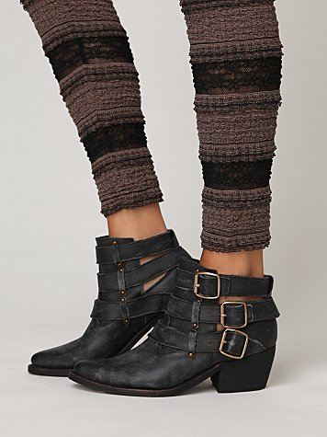
Purpose of fashion accessories in the fashion industry
Footwear – dress shoes, casual shoes, slippers, athletic shoes, sandals, and boots
Hosiery – pantyhose, stockings, and socks

Slide 28
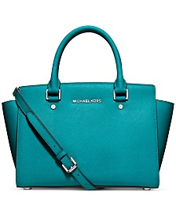
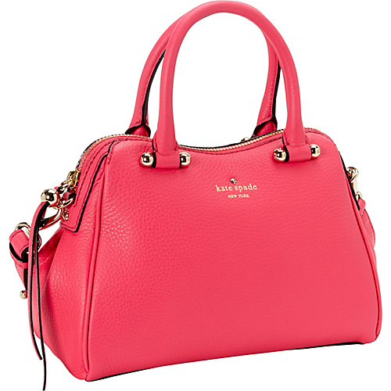
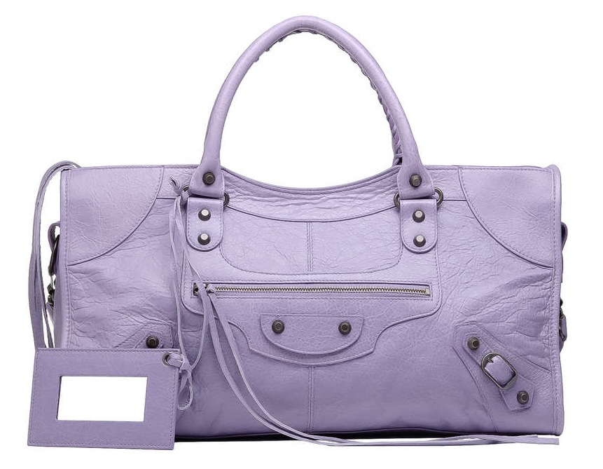
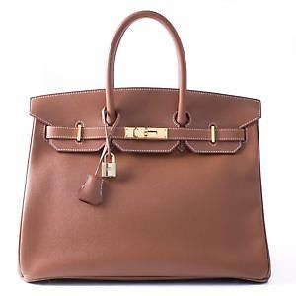
Purpose of fashion accessories in the fashion industry
Handbags and small leather goods – clutch, satchel, tote, shoulderbag, billfolds, checkbook cases, eyeglass cases, and briefcases

Slide 29
Purpose of fashion accessories in the fashion industry
Belts – rope, sash, cummerbund, and belts with buckles
Headwear – visors, hats, and caps
Handwear – gloves, mittens, and work gloves
Neckwear – scarves, shawls, and ties

Slide 30
Purpose of Accessories
Acccessories can extend wardrobes and add a variety by pulling different garments together and updating old ones. They are often impulse items( purchased on the spur of the moment without preplanning) and known to be extenders(can be mixed and matched within a wardrobe for more outfits.

Slide 31
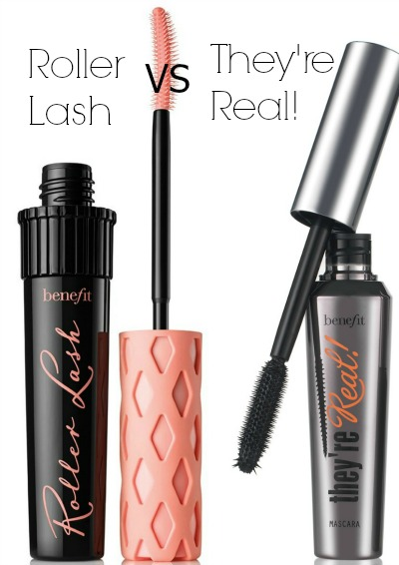
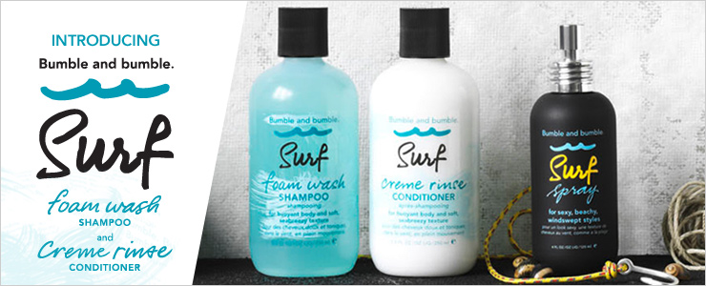
Cosmetics as Accessories
Cosmetics: Products applied to the face, skin, or hair to improve appearance. Examples: toner, blush, eye shadow, and lipstick
Toiletries: Personal care products used in grooming. Examples: deodorant, shampoo, and conditioner
Fragrances: Products that add a pleasant scent such as perfume, cologne, and bath products. Examples: Givenchy Amarige, Calvin Klein’s CK One, and bubble baths

